Slide 1


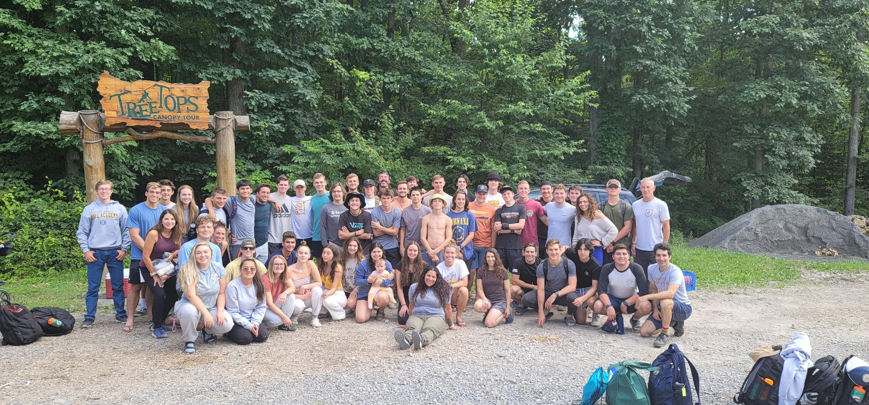
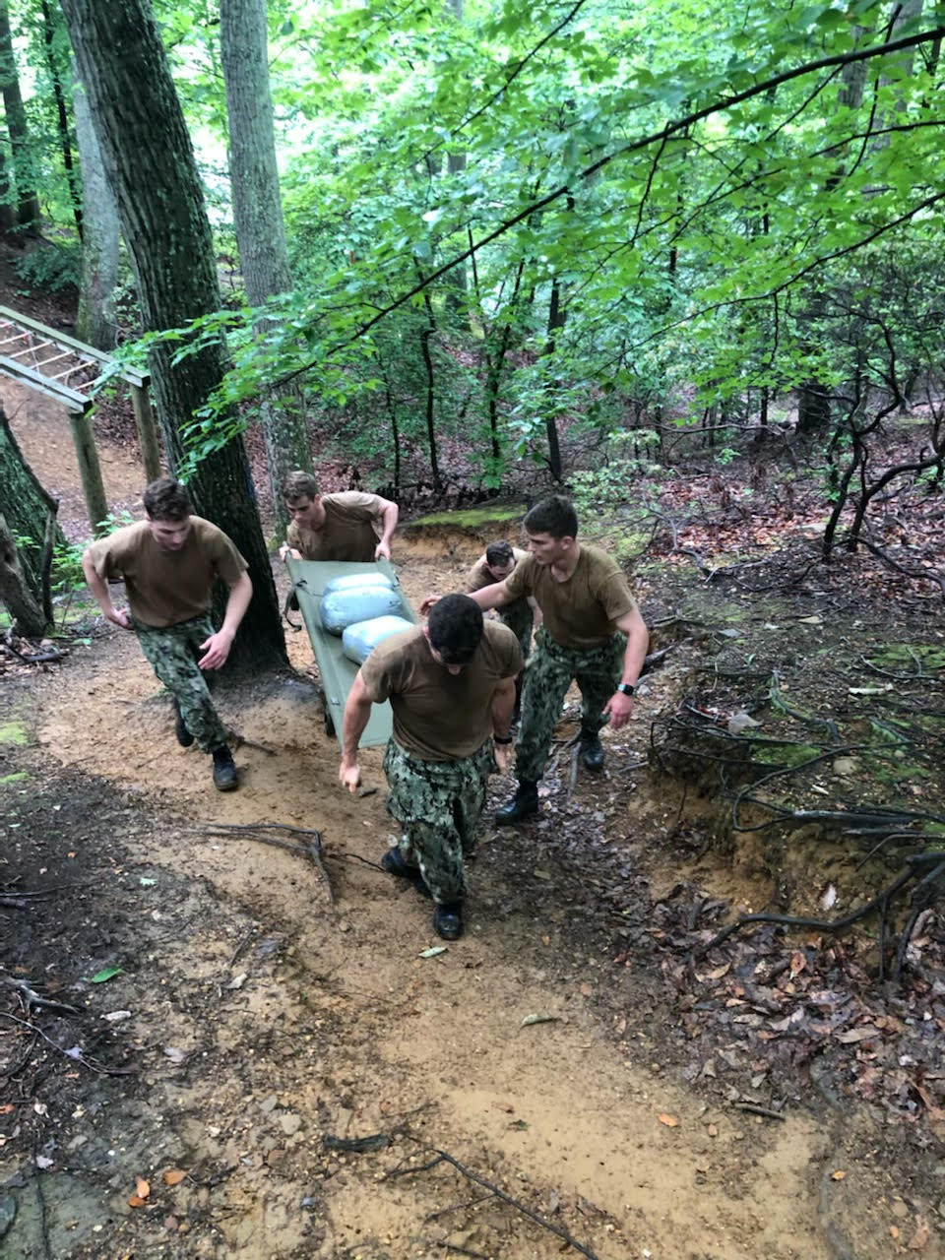
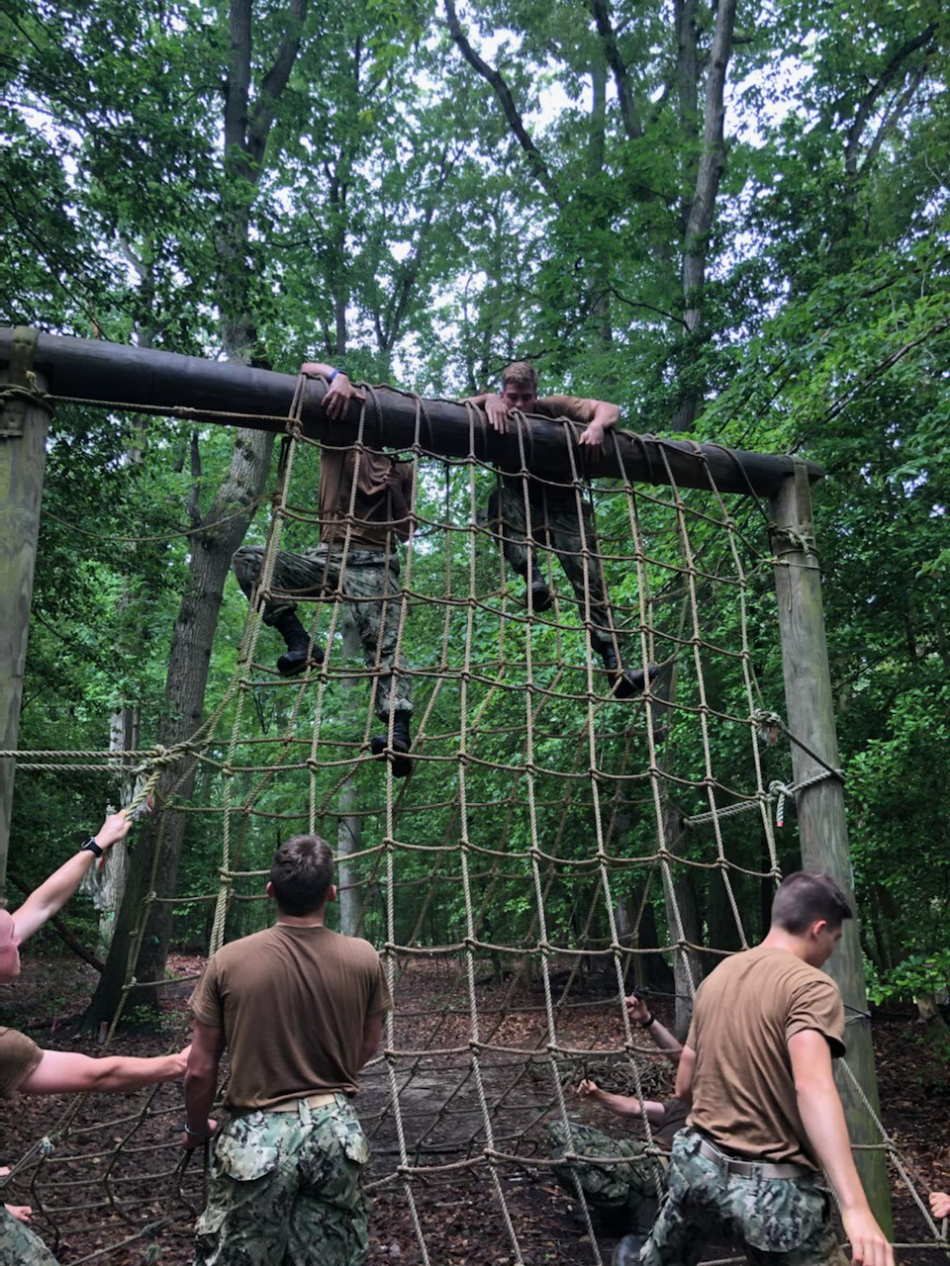
UNCLASSIFIED//FOUO
USNA NSW Professional Training Event (Block 1)
WHO:
10 x Class of 2023 USNA Midshipmen (MIDN)
WHAT: Professional Development providing an all-encompassing look into the NSW community.
WHERE:
USNA - Annapolis, MD
NSW GROUP TWO - JEB Little Creek, VA
New River Gorge - Victor, WV
WHEN: 02-27 JUN 2021
WHY: This training enables MIDN to interact with SEAL enlisted and officers at NSW Commands to gain real world exposure into the NSW Community. Midshipmen bring valuable perspective back to the Brigade of MIDN allowing them to make informed decisions prior to screening and service selection.
Scheme of Maneuver:
Week 1 - USNA
Week 2 - NSW GROUP TWO
- Briefs from: Group 2, 4, 10, SDVT-2, ST-10, Intel
- Training: Mission Planning, Basic Patrolling, CQC,
TRIDENT, iFly
Week 3 - Camp Legacy Mentors (Navy SEAL Foundation)
Camp Legacy - New River Gorge National Park, WV
“Down Man” Endurance Course - USNA
UNCLASSIFIED//FOUO

Slide 2
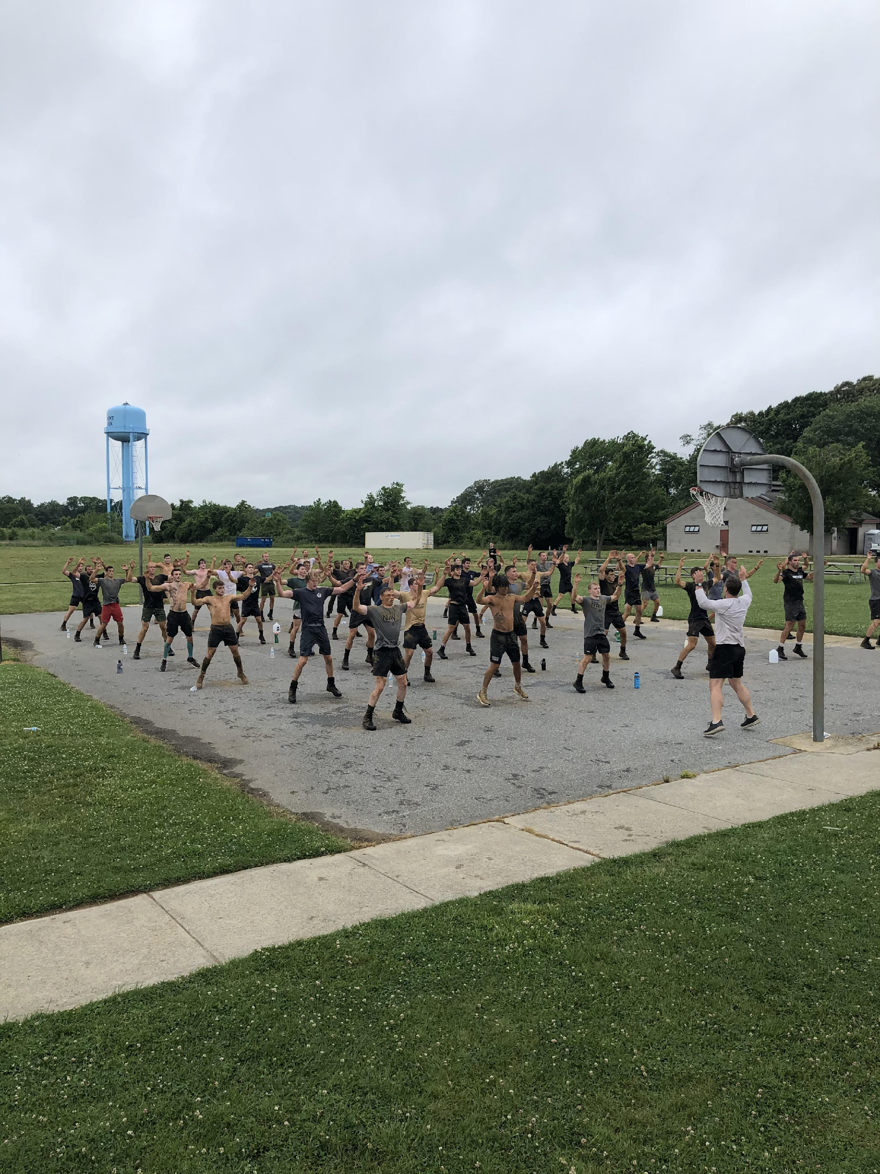
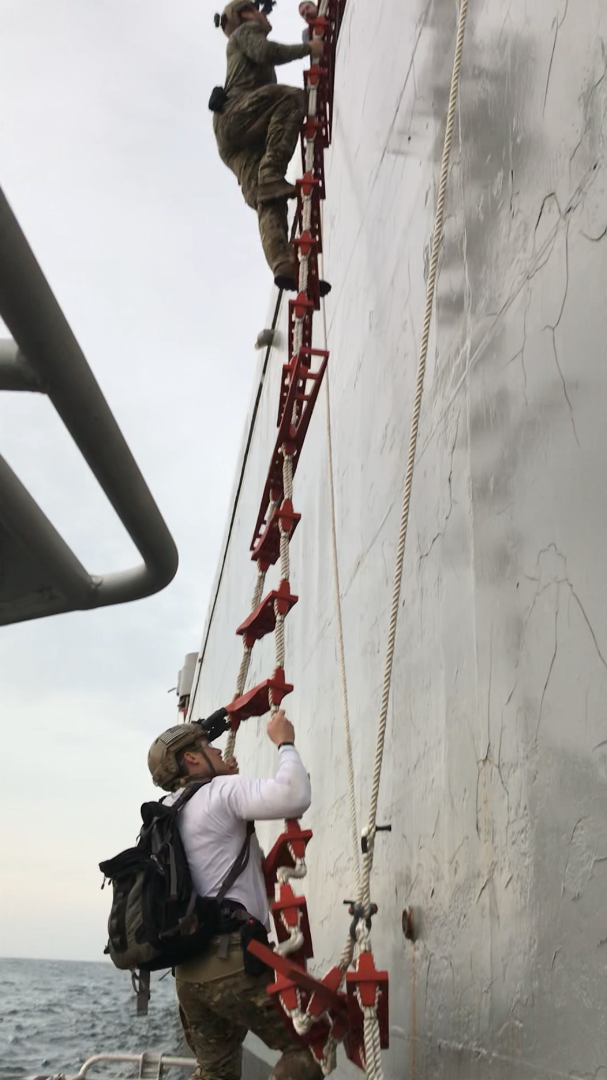
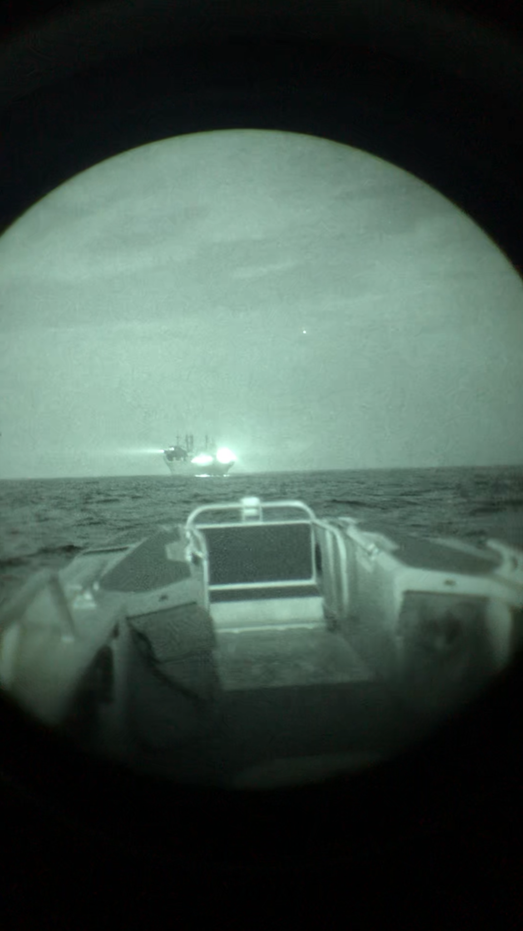
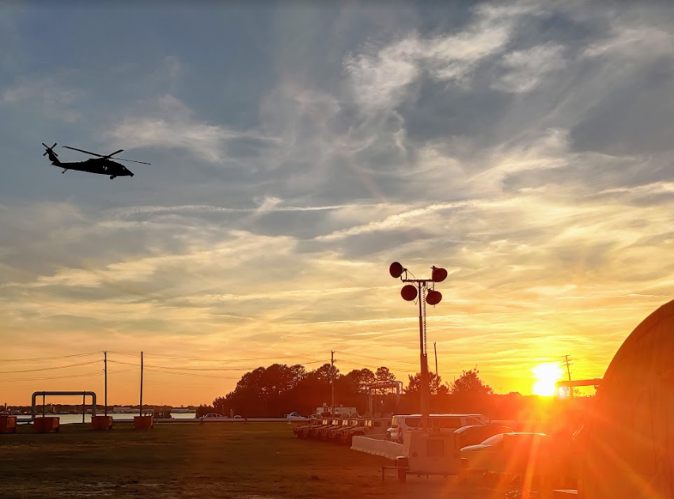
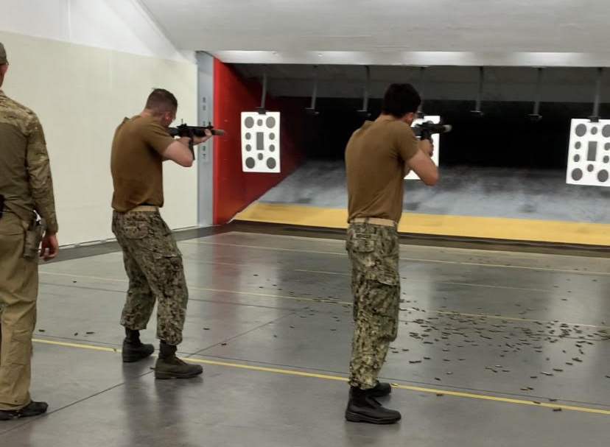
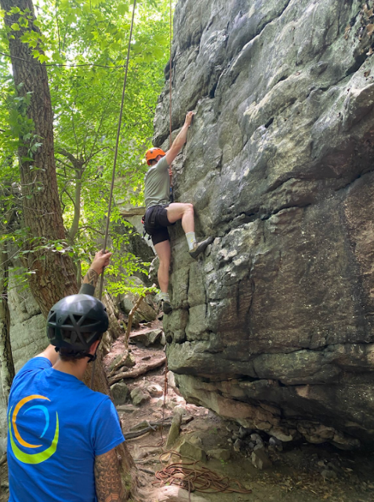
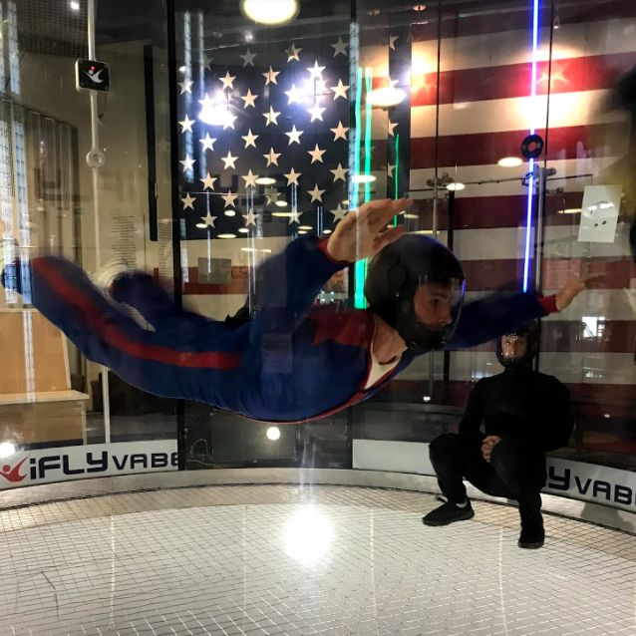
UNCLASSIFIED//FOUO
NSW PTE Block 1
Grinder PT – Sandy Point Annapolis, MD
TRIDENT Exercise
TRIDENT Exercise
Small Arms Range
Camp Legacy
iFLY
UNCLASSIFIED//FOUO

Slide 3
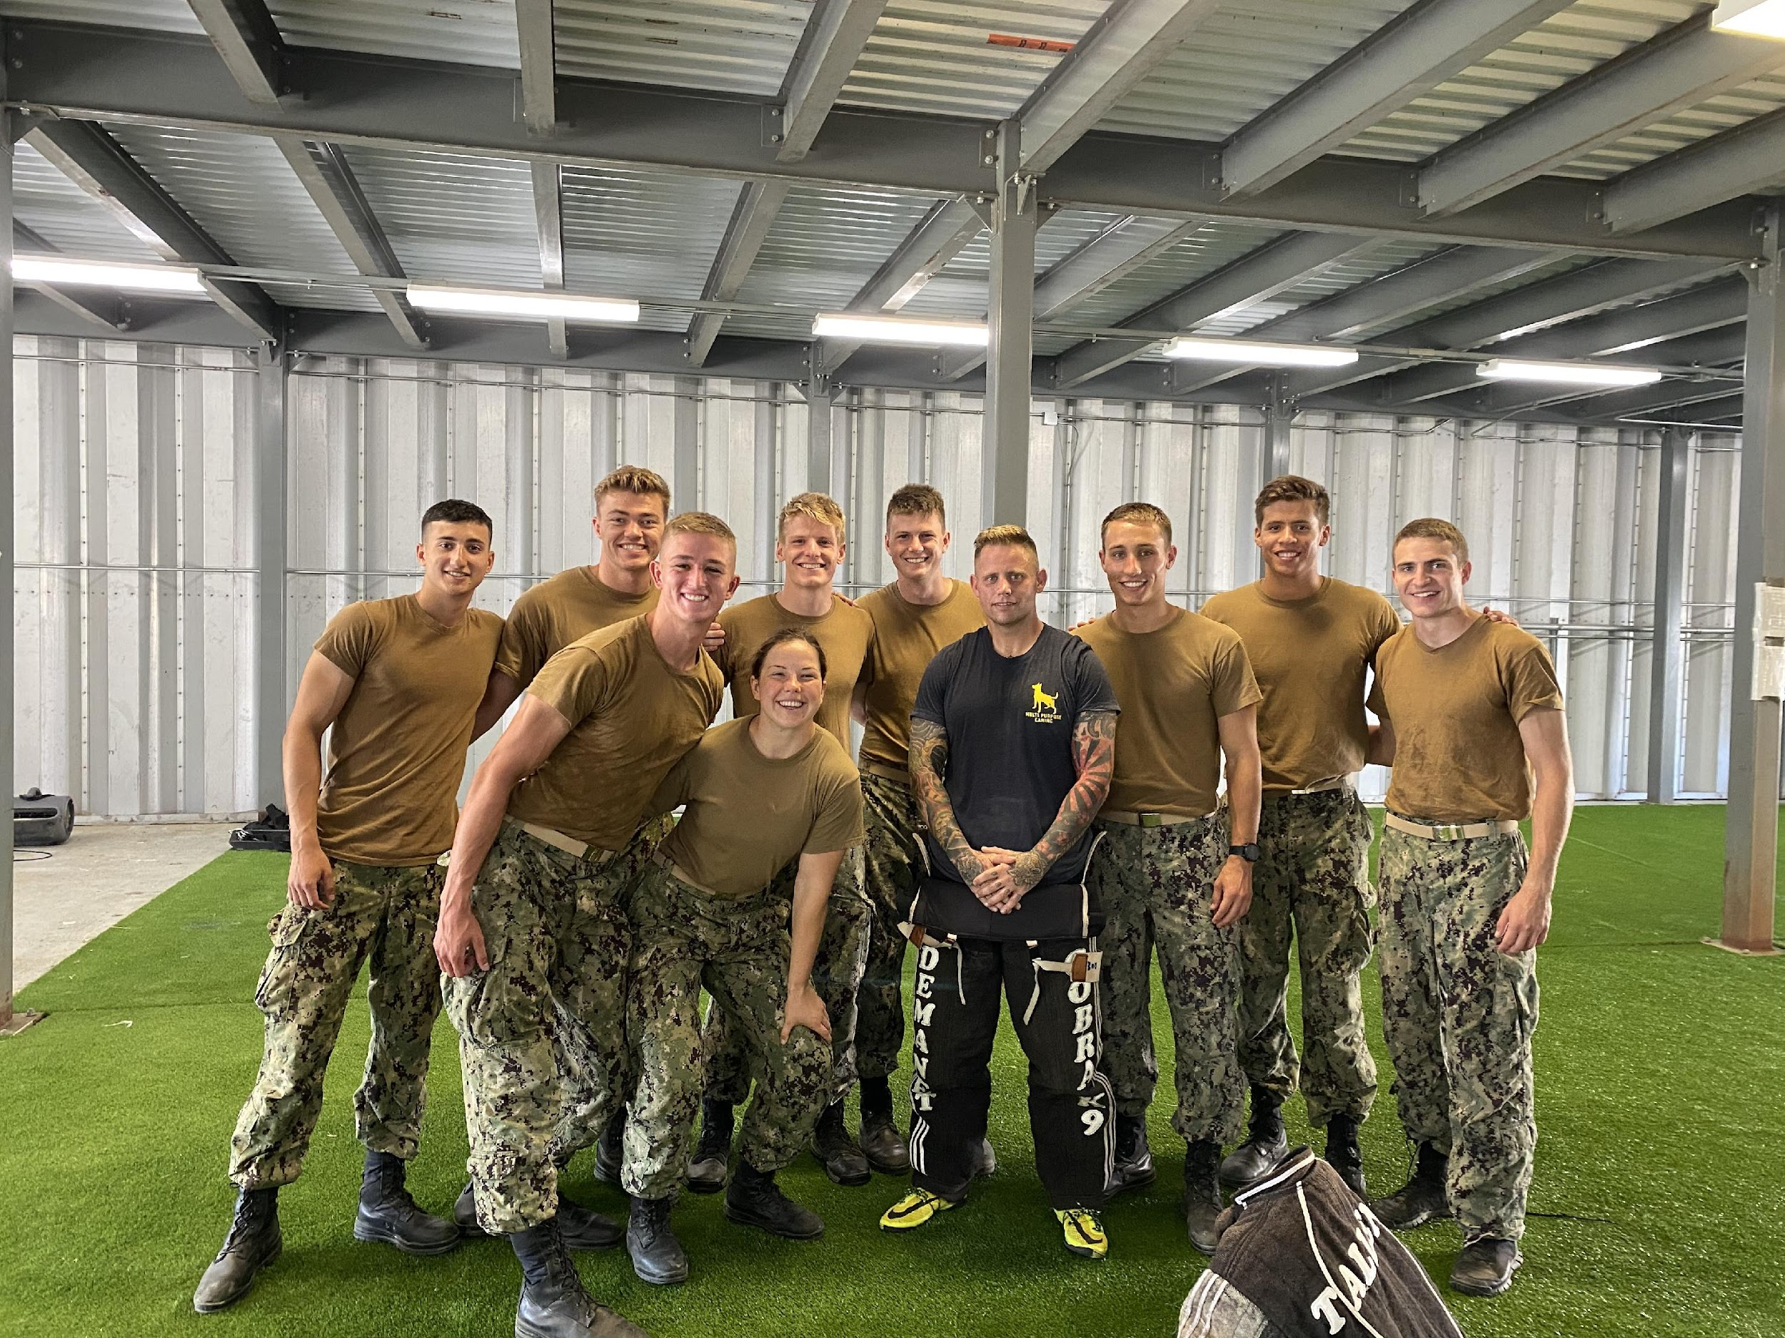
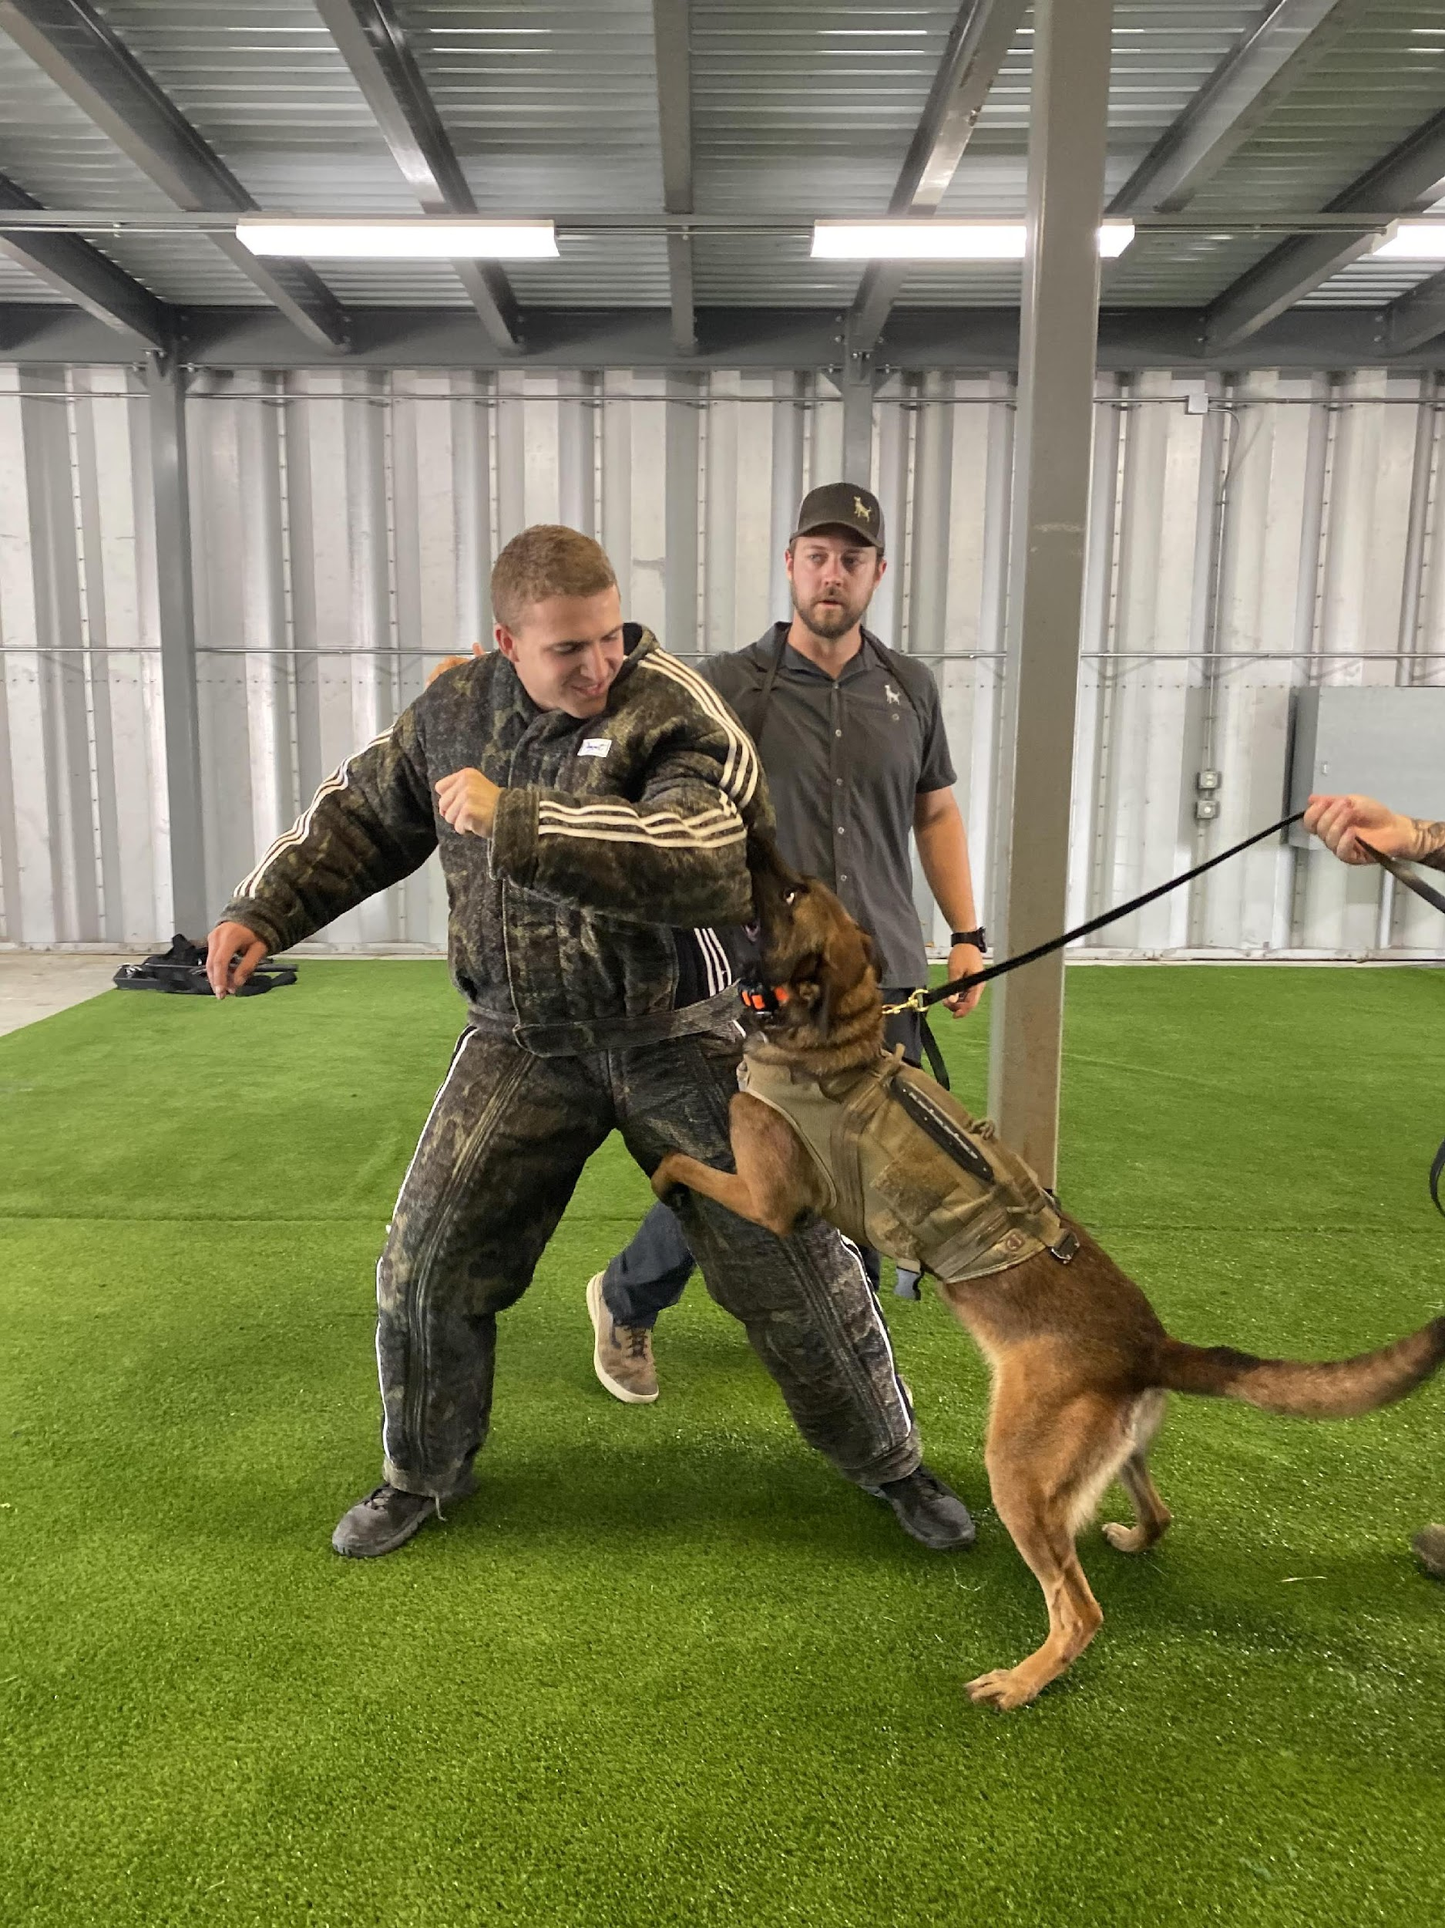
UNCLASSIFIED//FOUO
NSW PTE BLOCK 2
WHO:
10 x Class of 2023 Midshipmen
1 x USNA SEAL Program Staff
1 x NSW Group 2 SEAL
WHAT: Class of 2023 NSW Exposure
WHERE: Annapolis, MD; JEB Little Creek, VA
WHEN: 30JUN21-16JUL21
WHY: To provide exposure for rising 2/C to the NSW community.
Scheme of Maneuver:
-5 days at USNA with LCDR Beitler
-12 days at JEB Little Creek, VA.
Multi-Purpose Canine - JEB Little Creek, VA
UNCLASSIFIED//FOUO

Slide 4
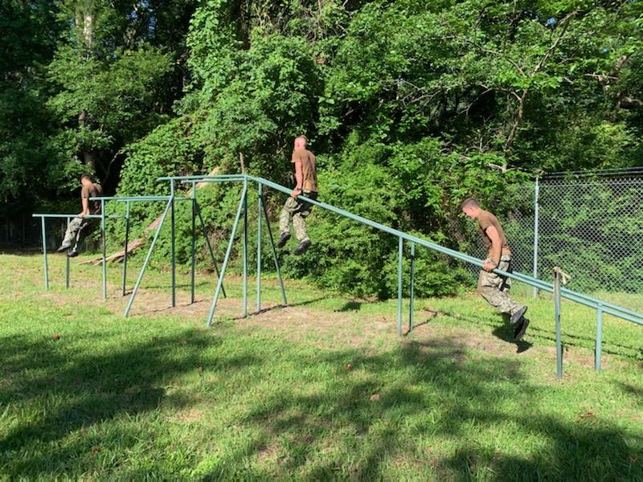
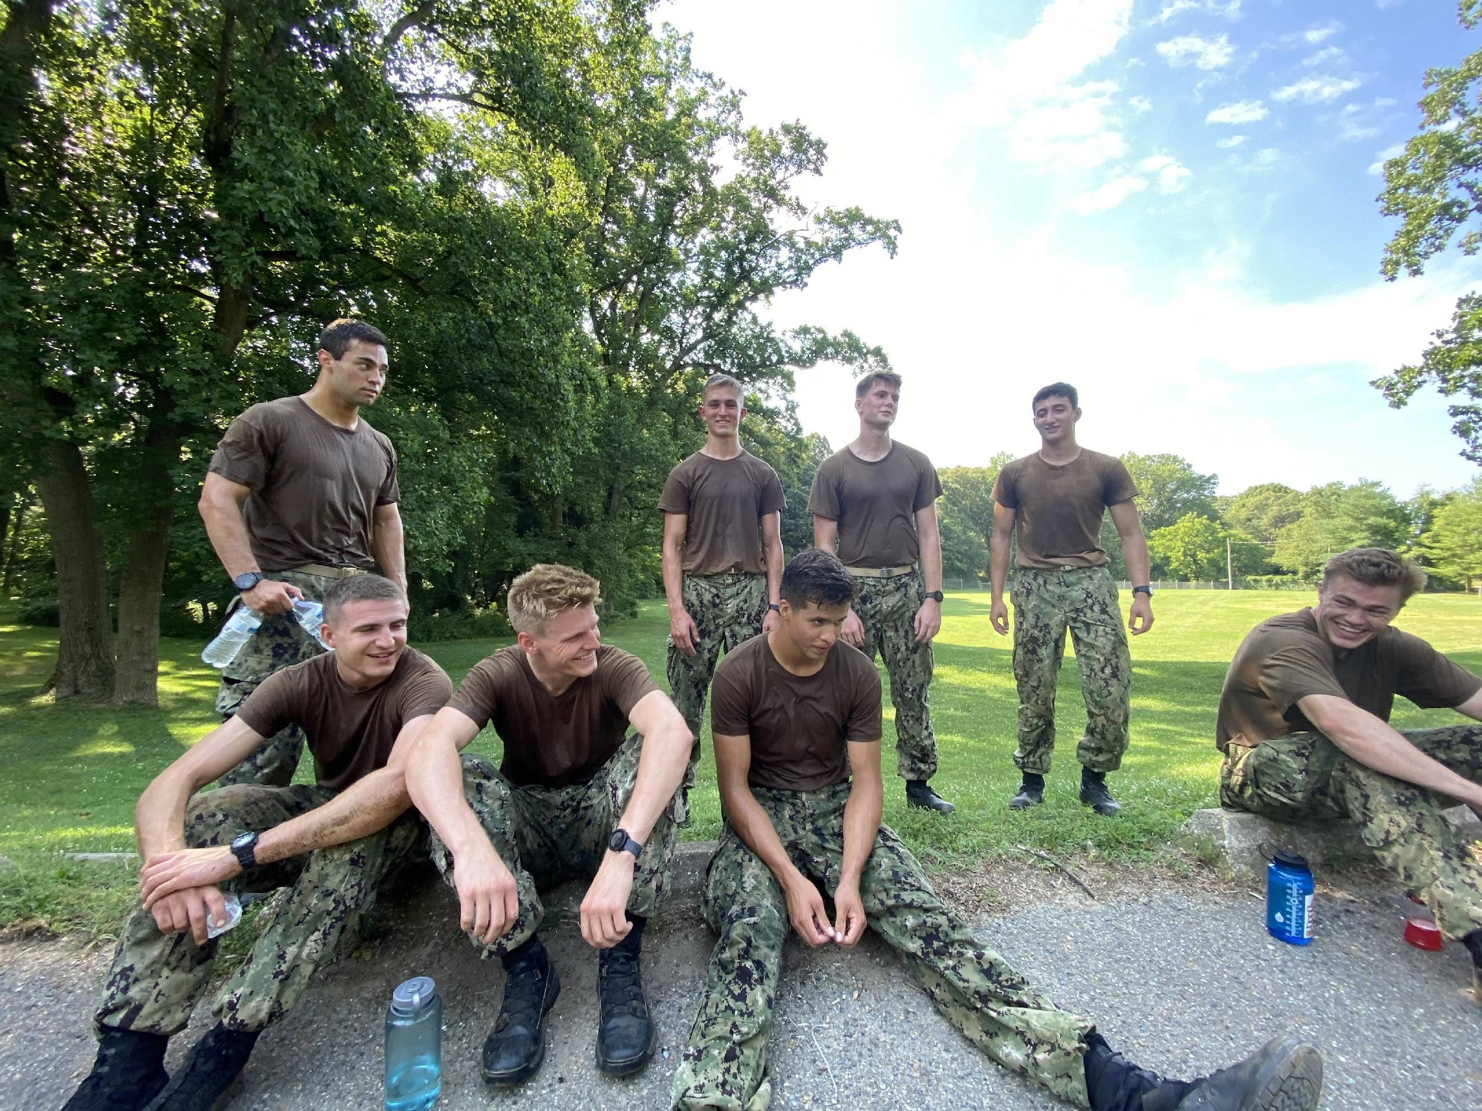
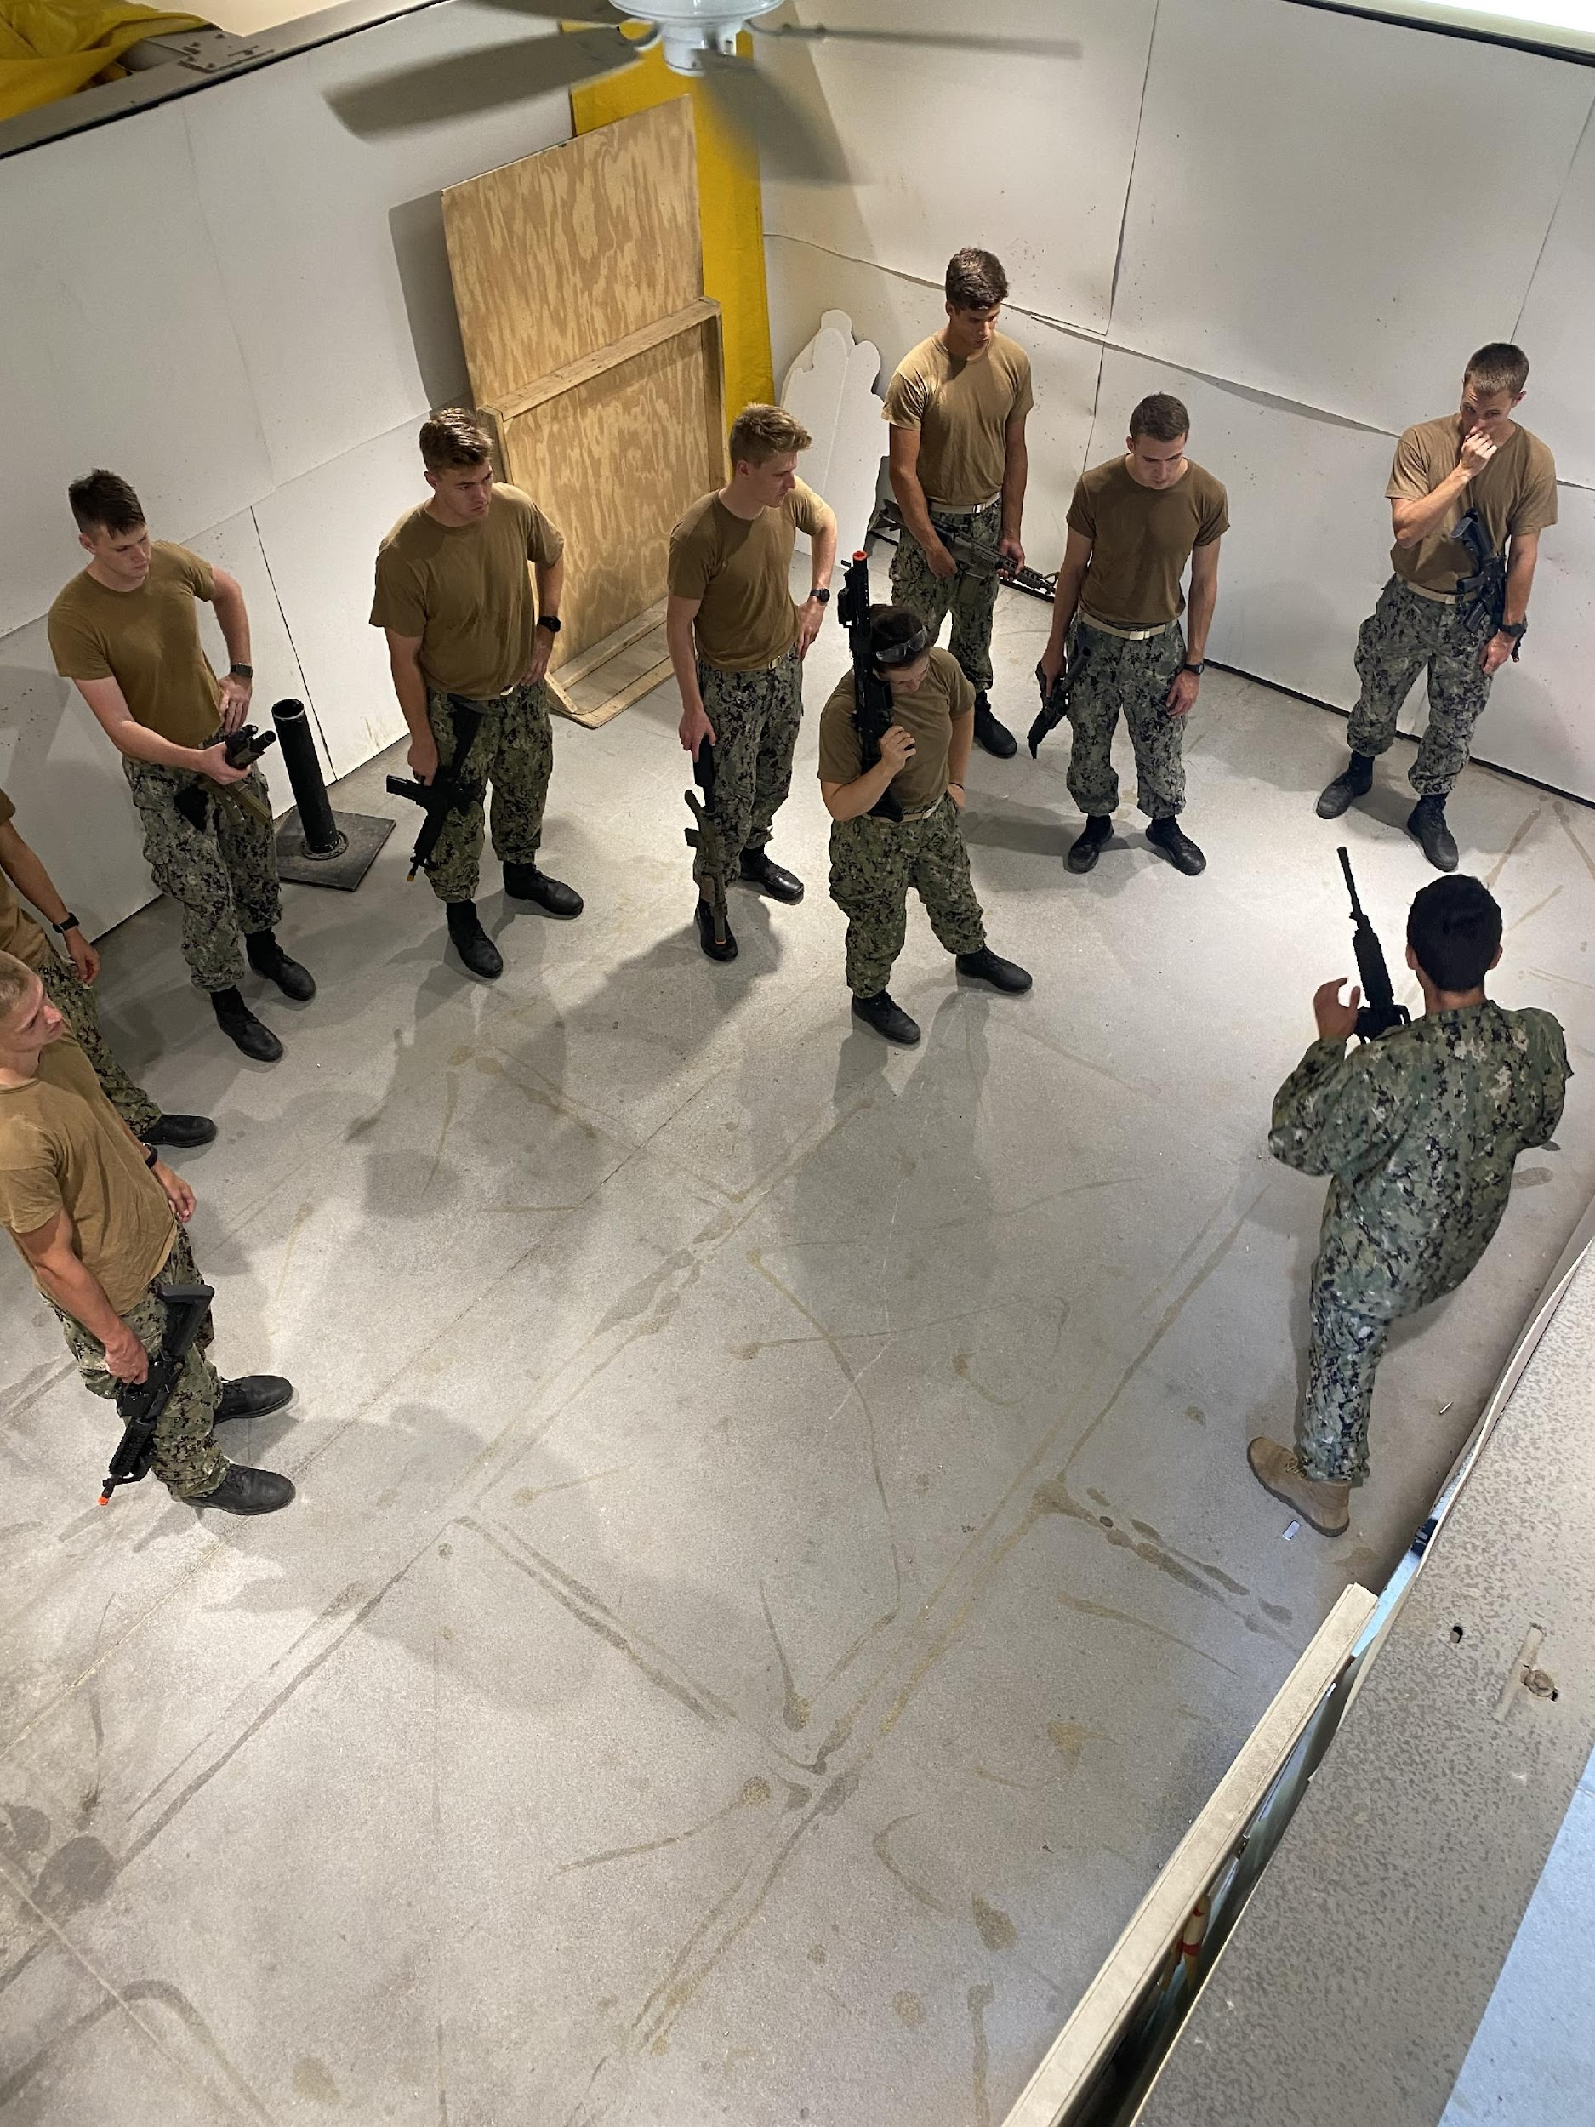
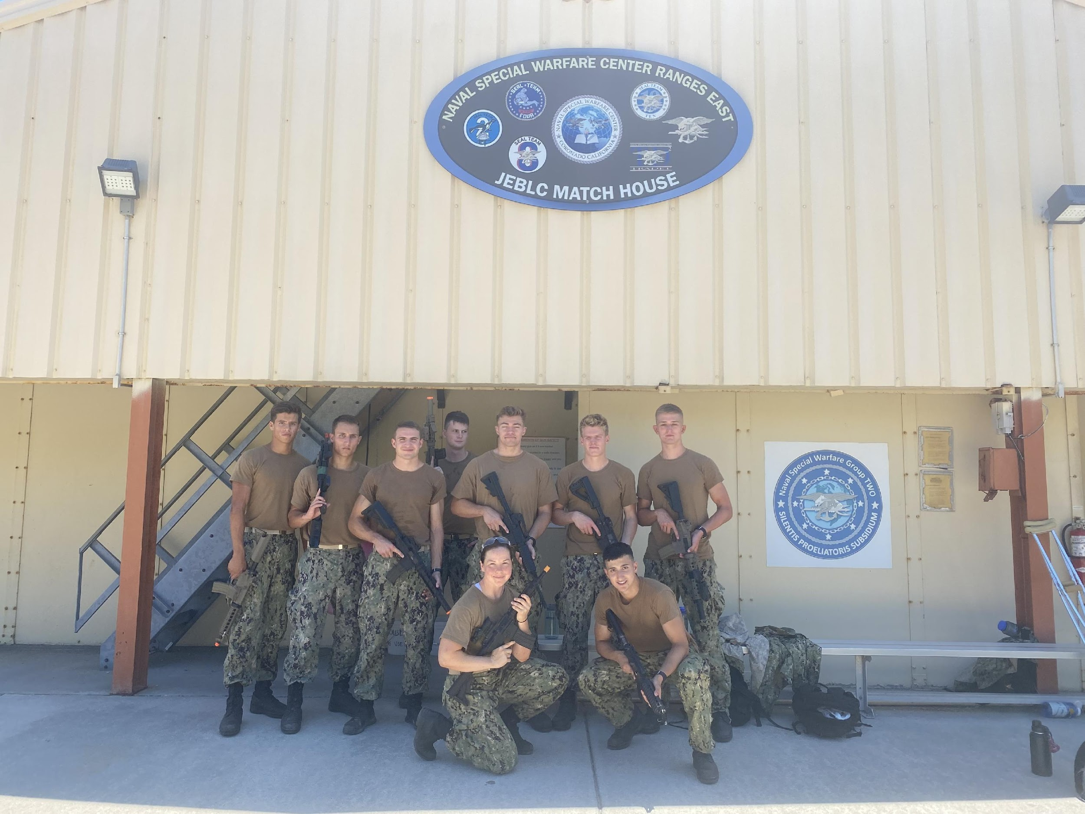
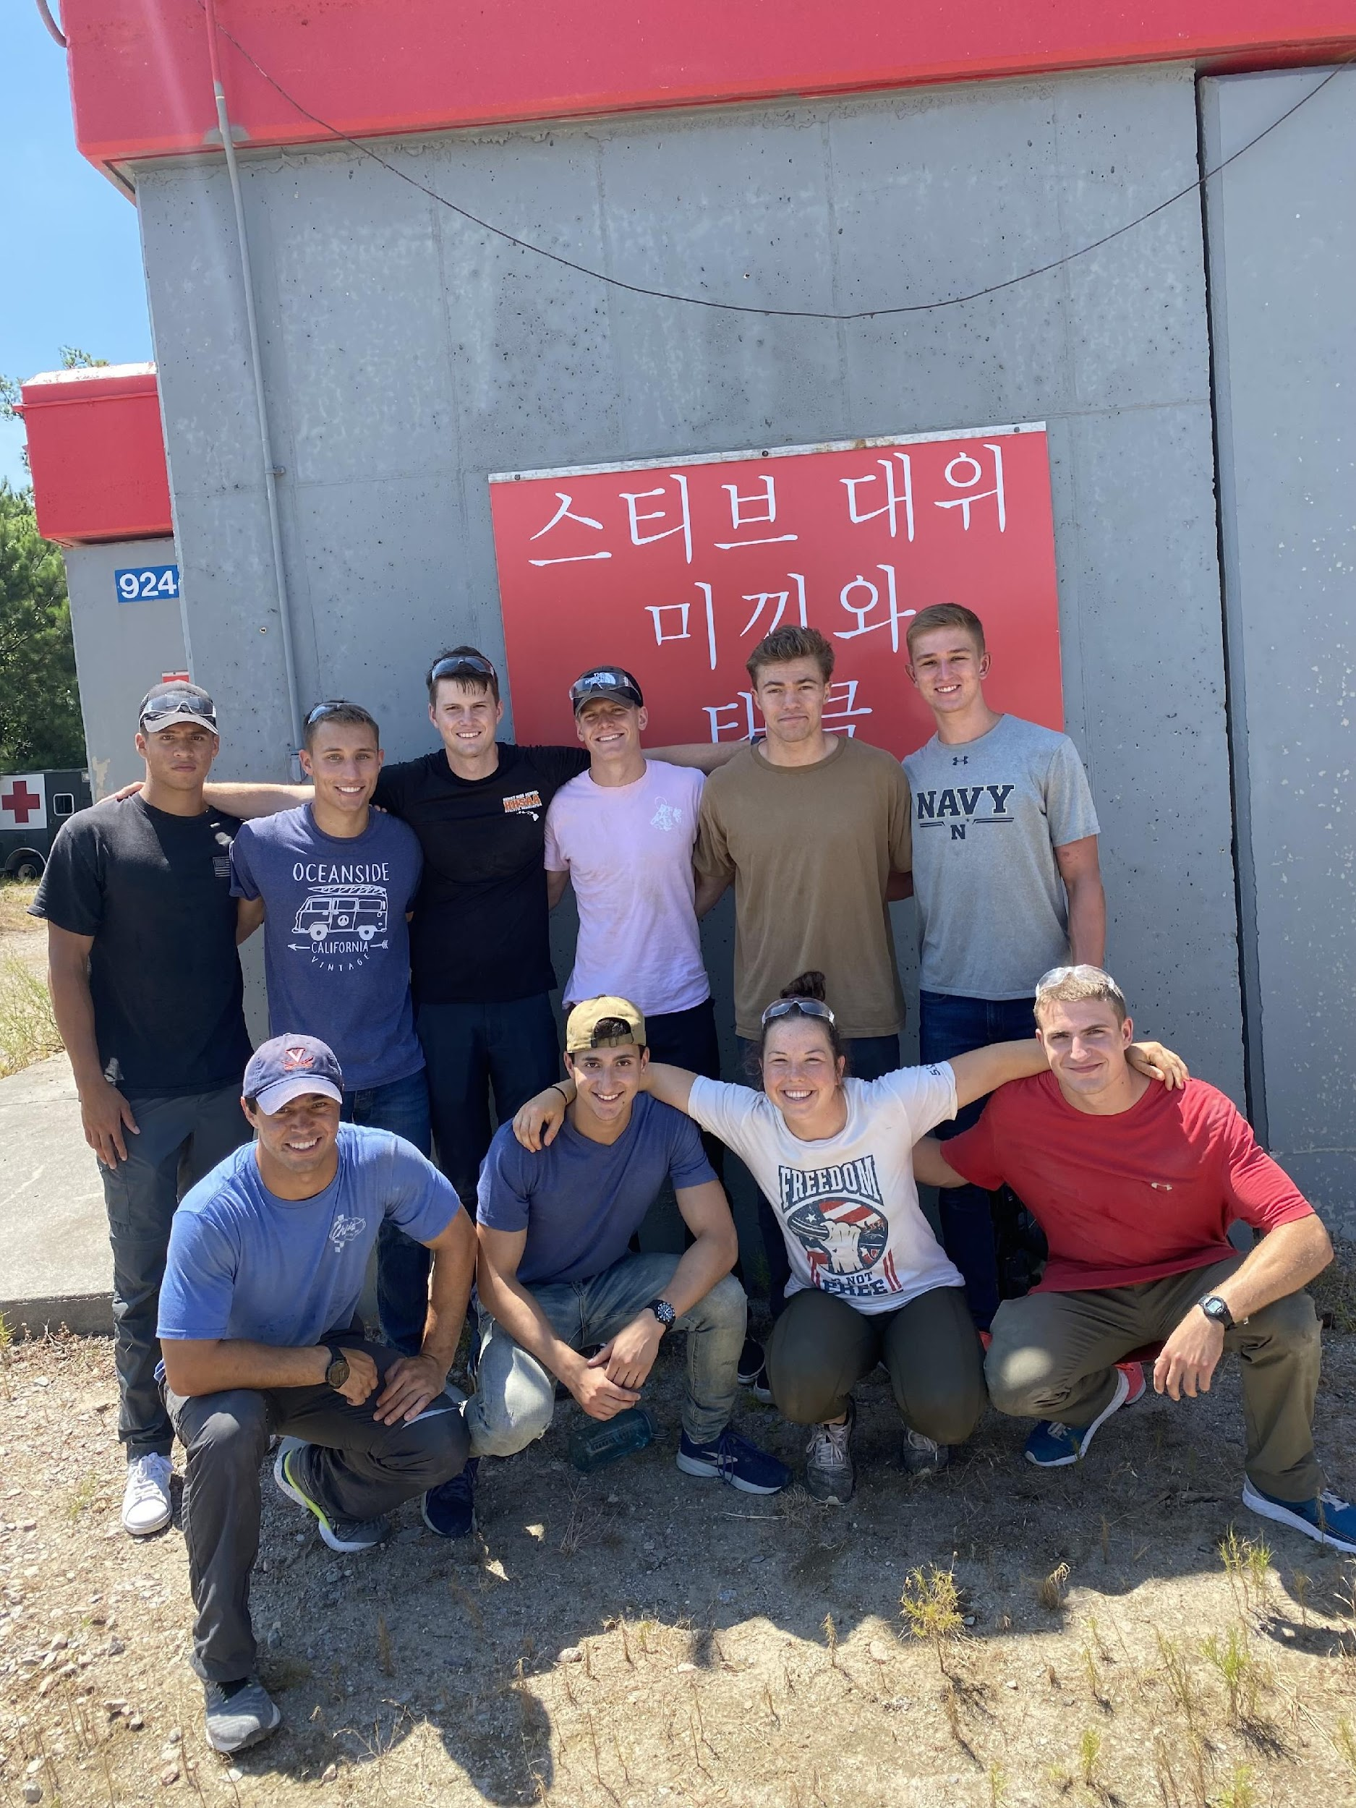
UNCLASSIFIED//FOUO
NSW PTE BLOCK 2
High Obstacle/Confidence Course
“Down Man” Endurance Course
CQC Course- LT Jack Kuenzle
Match House
Role-players for SEAL Team 8 CQC
UNCLASSIFIED//FOUO

Slide 5
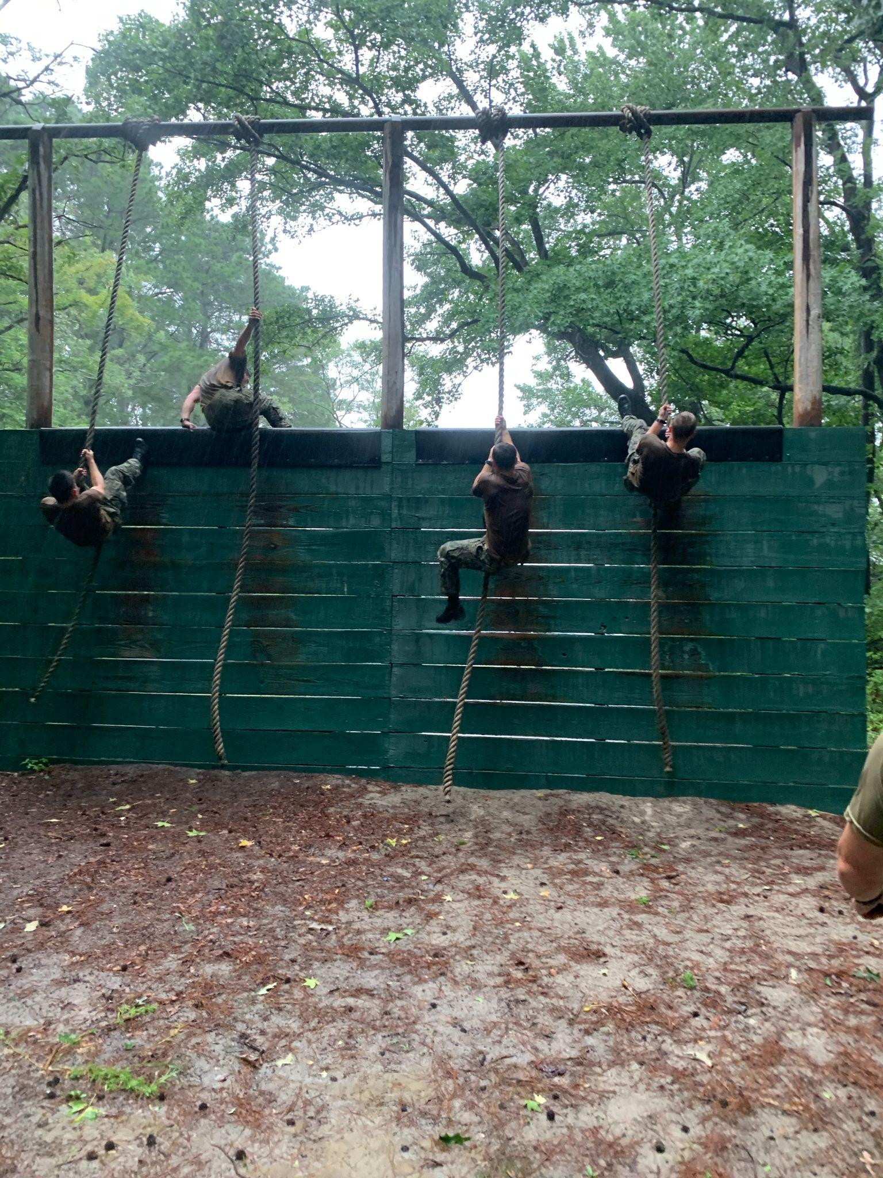
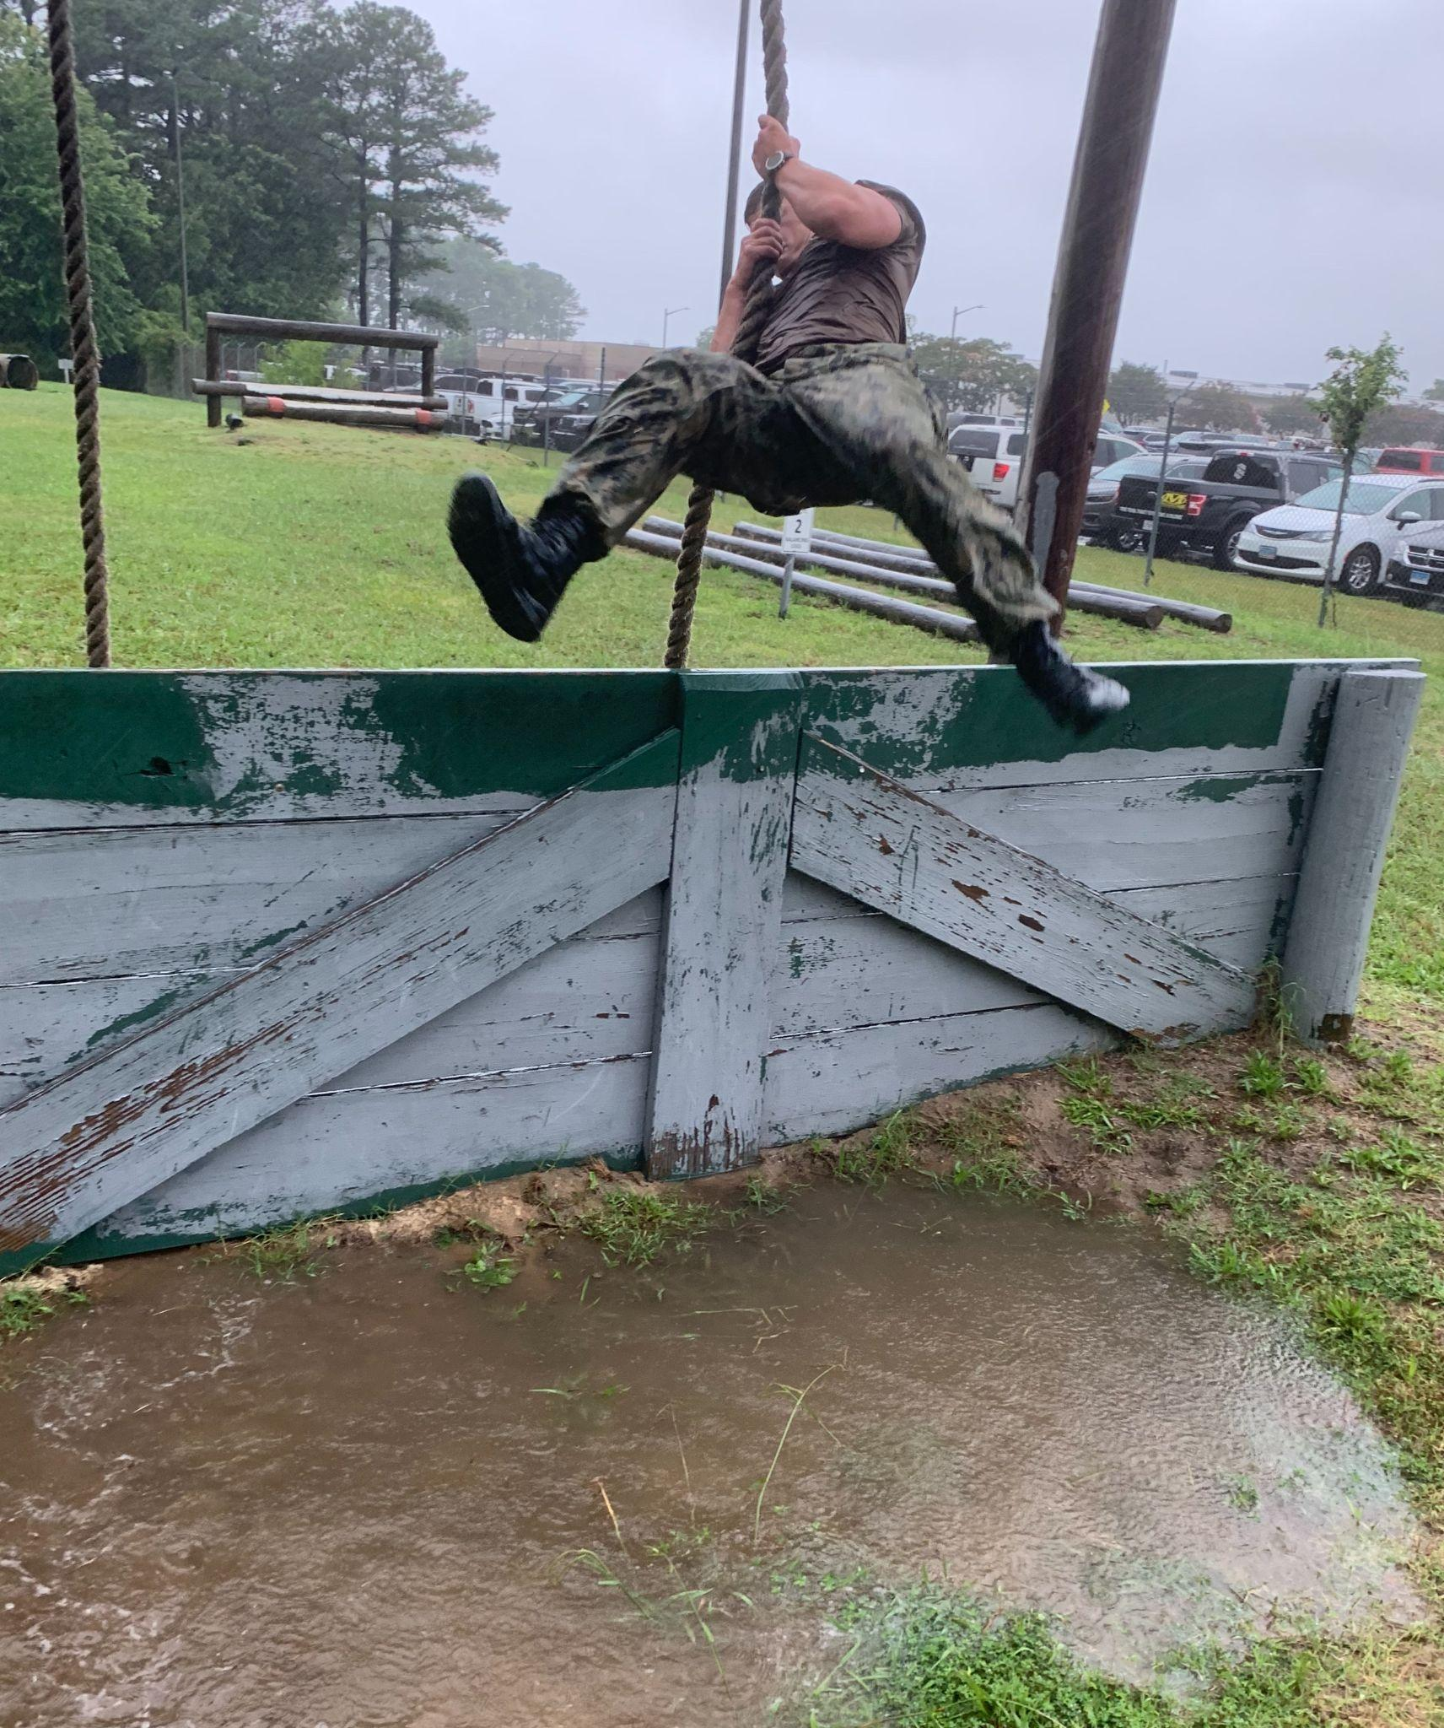
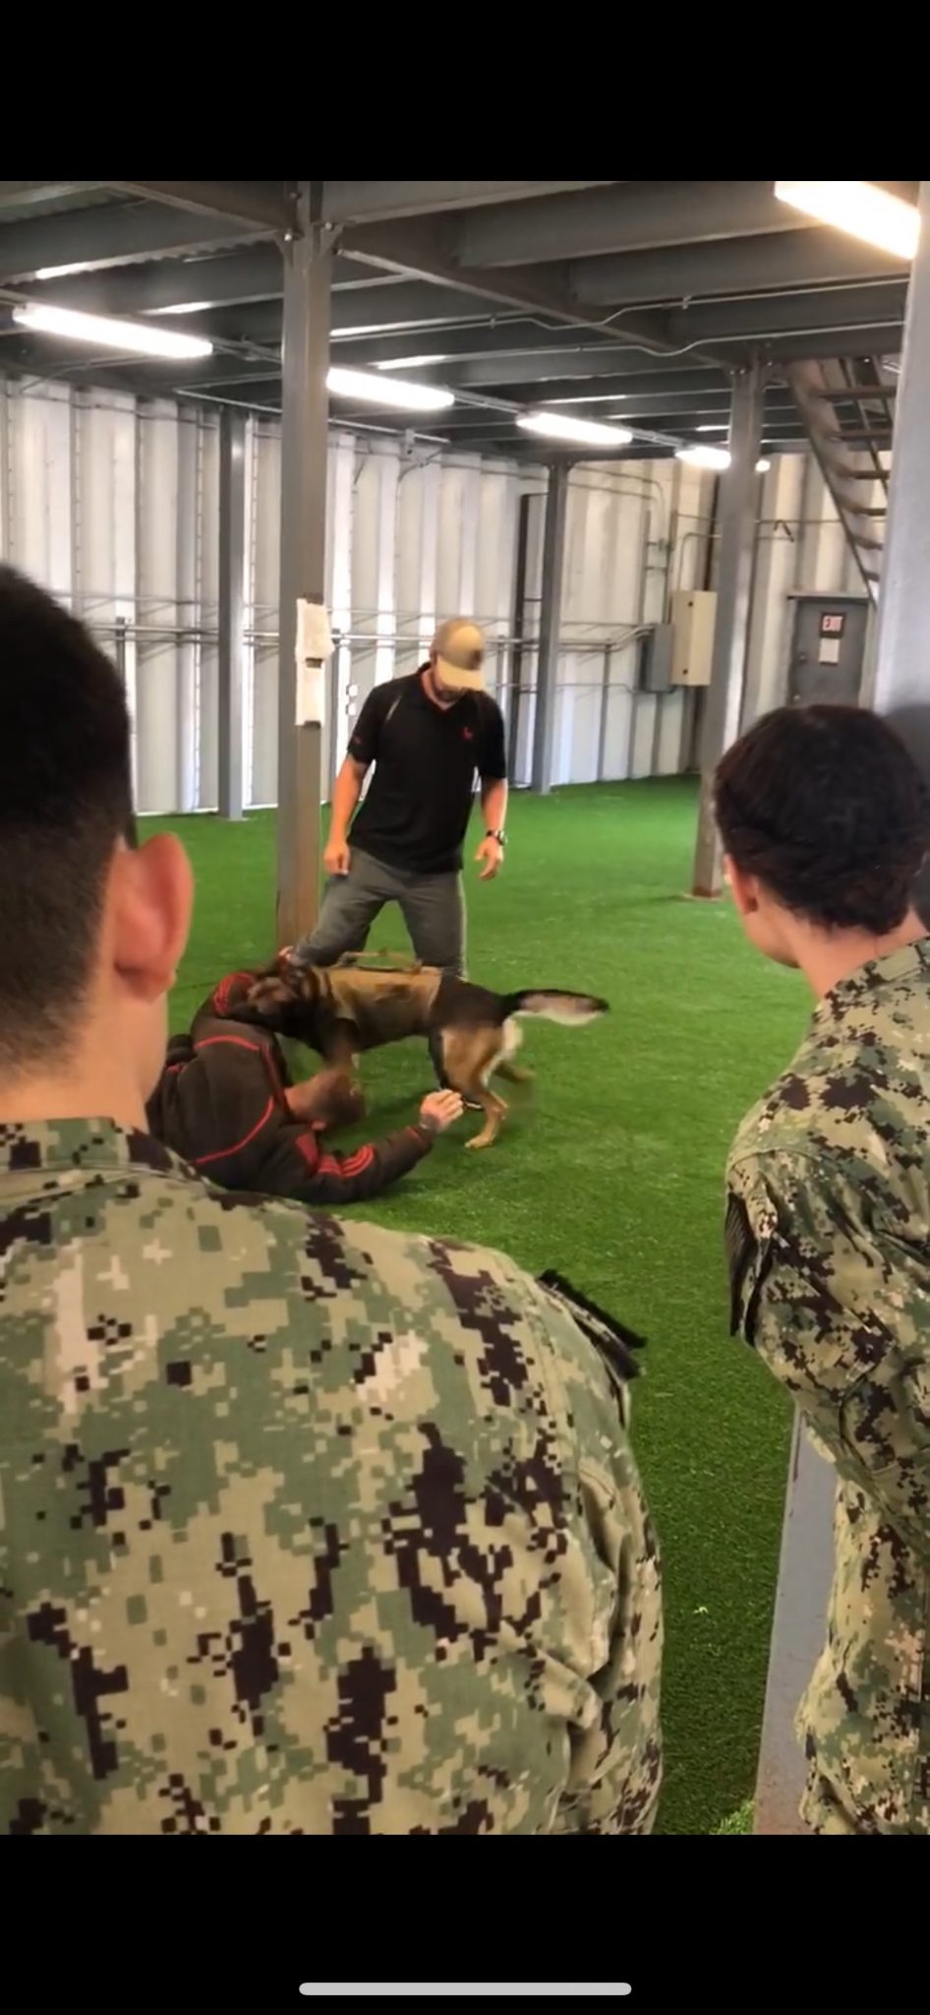
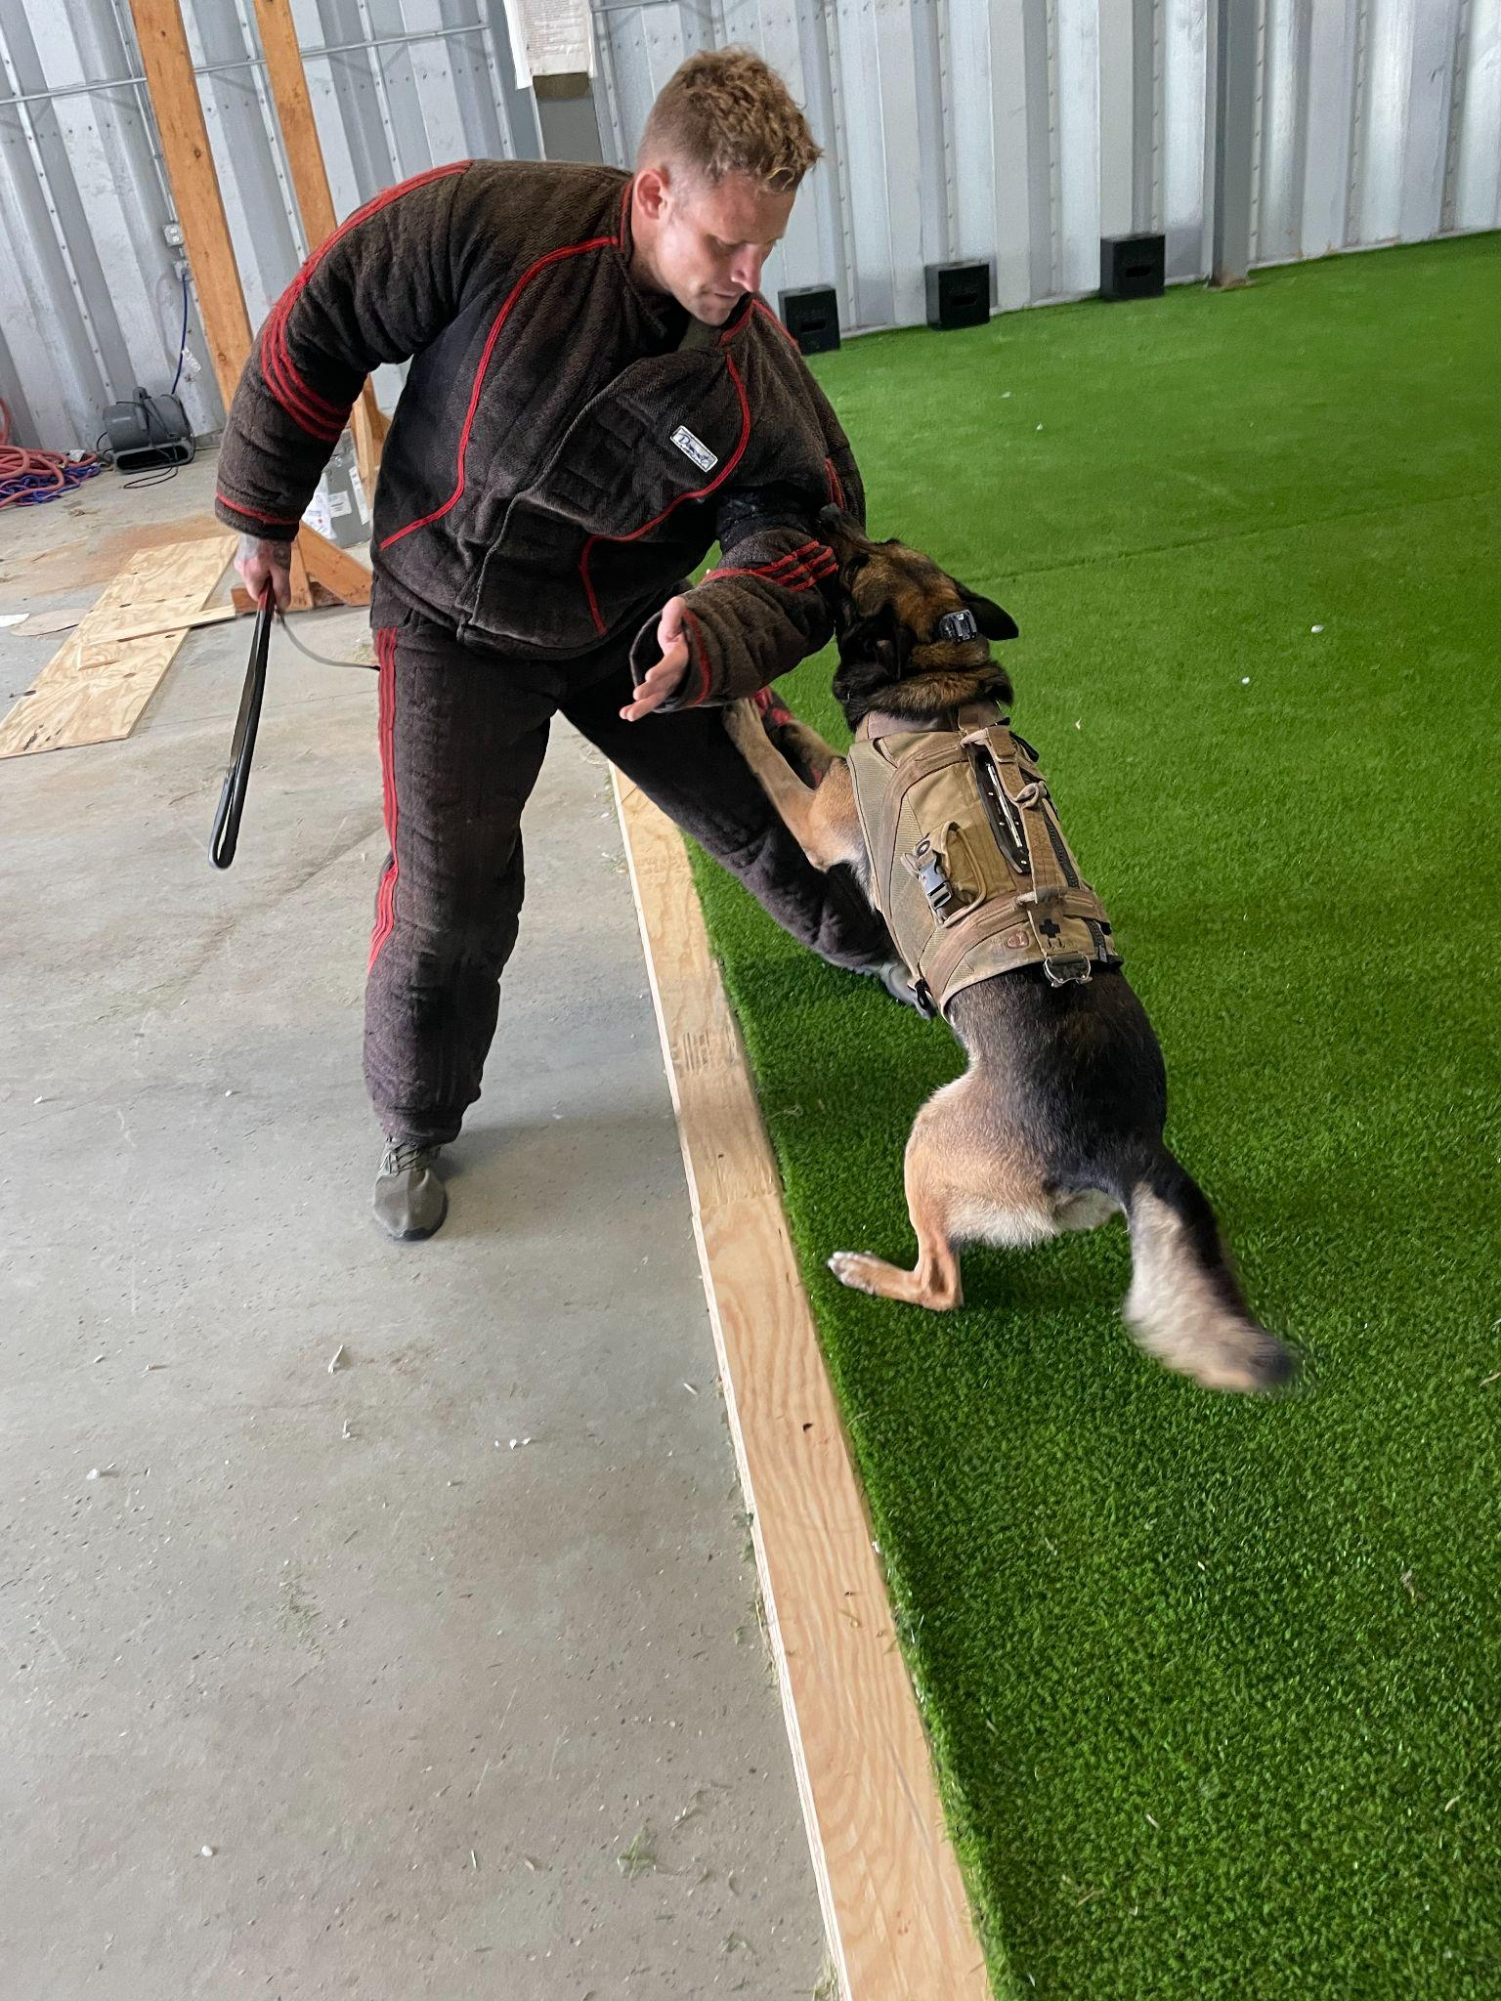
UNCLASSIFIED//FOUO
NSW PTE BLOCK 3
WHO:
9 x Class of 2023 USNA NSW Candidates
1 x Class of 2023 USMMA Cadet
1 x USNA SEAL Program Staff
East Coast SEALs and Support
WHAT: Class of 2023 Block 3 NSW PTE
WHERE: Annapolis, MD; JEB Little Creek, VA.
WHEN: 28 JULY - 13 AUG
WHY: To provide exposure for rising 2/C to the NSW community.
Scheme of Maneuver:
- 5 days at USNA with LCDR Beitler
- PST, E-Course, O-Course, TAD Workout, Briefs
-12 days at JEB Little Creek, VA
- PST, High/Low O-Course, Gun Range
- 5 days of TRADET CQC Roleplay/Live Fire Observation
- Briefs / Q&A’s with:
- SRT, SDV, MPC, NSWG 2, SWCC
- Group 2 SEAL Commodore
Running the Group 2 Low Obstacle Course at JEB Little Creek
“Hutch” taking down a target during a demo and tour of MPC unit supporting Group 2
UNCLASSIFIED//FOUO

Slide 6
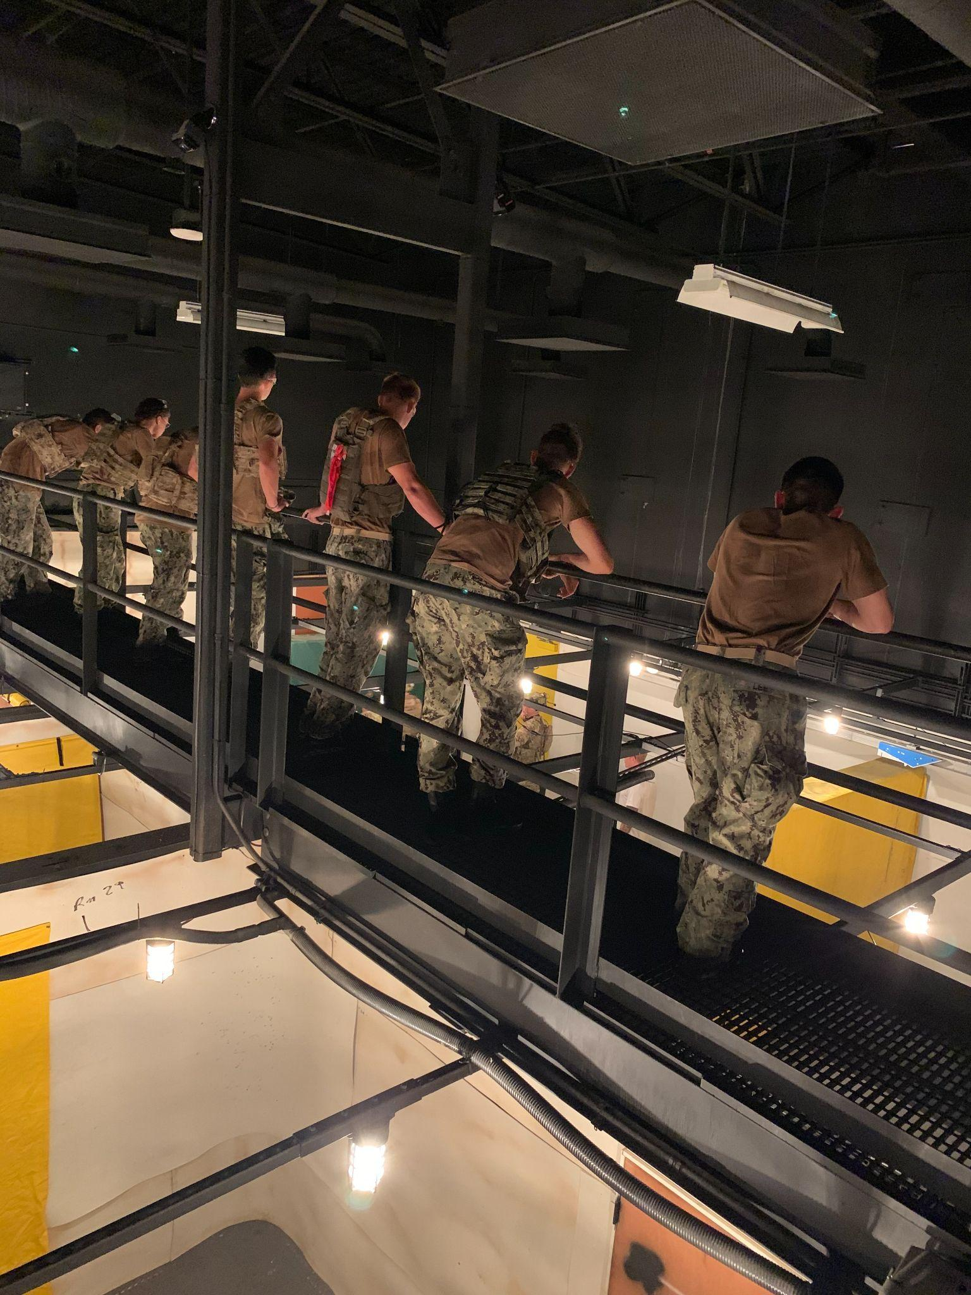
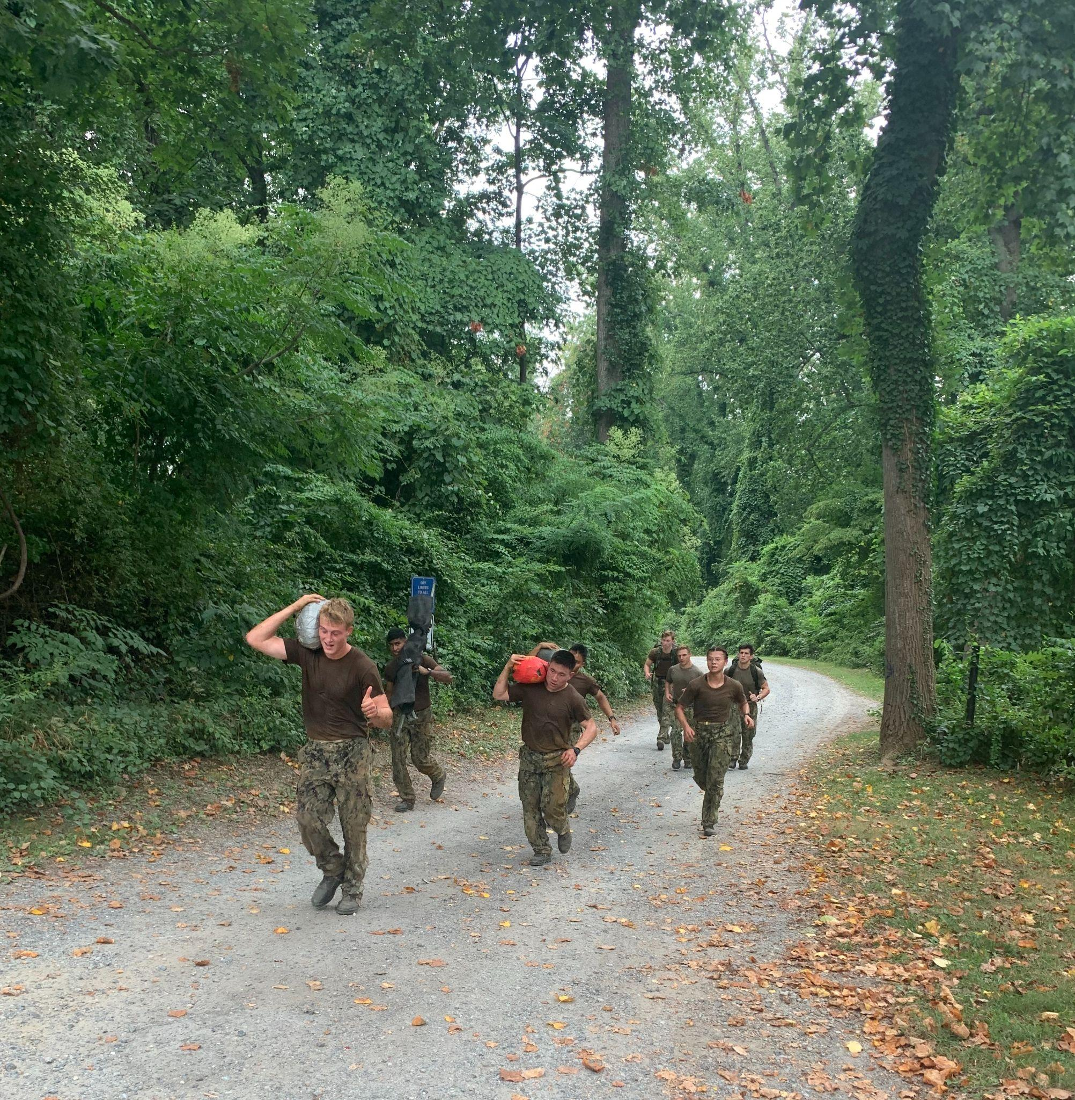
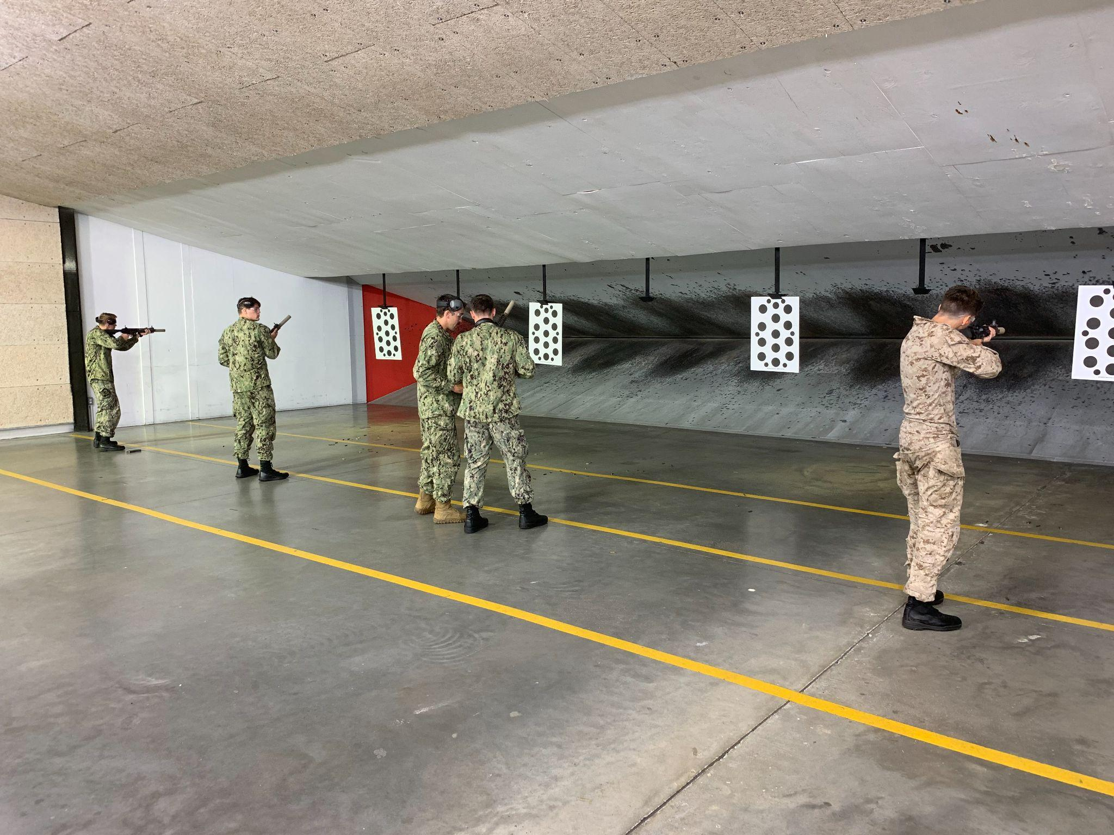
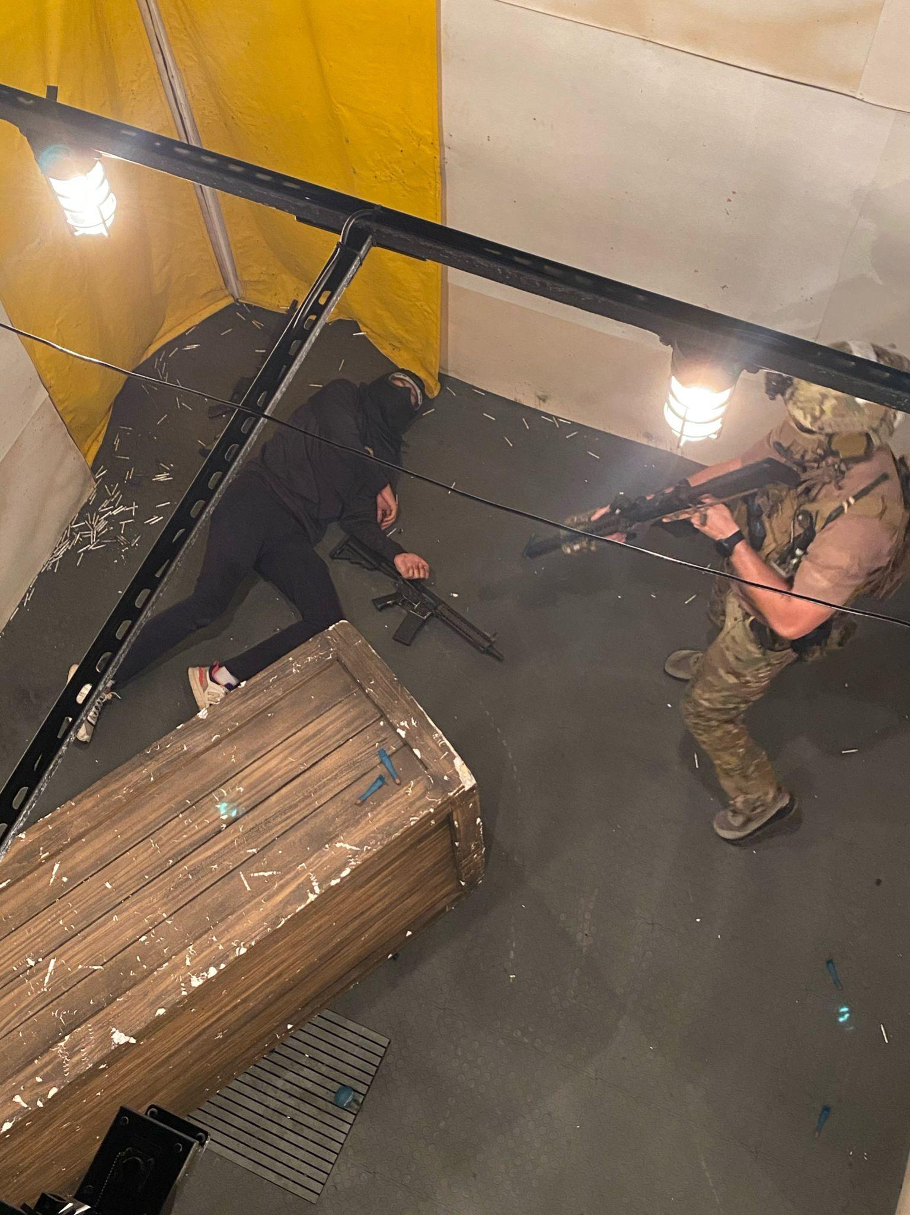
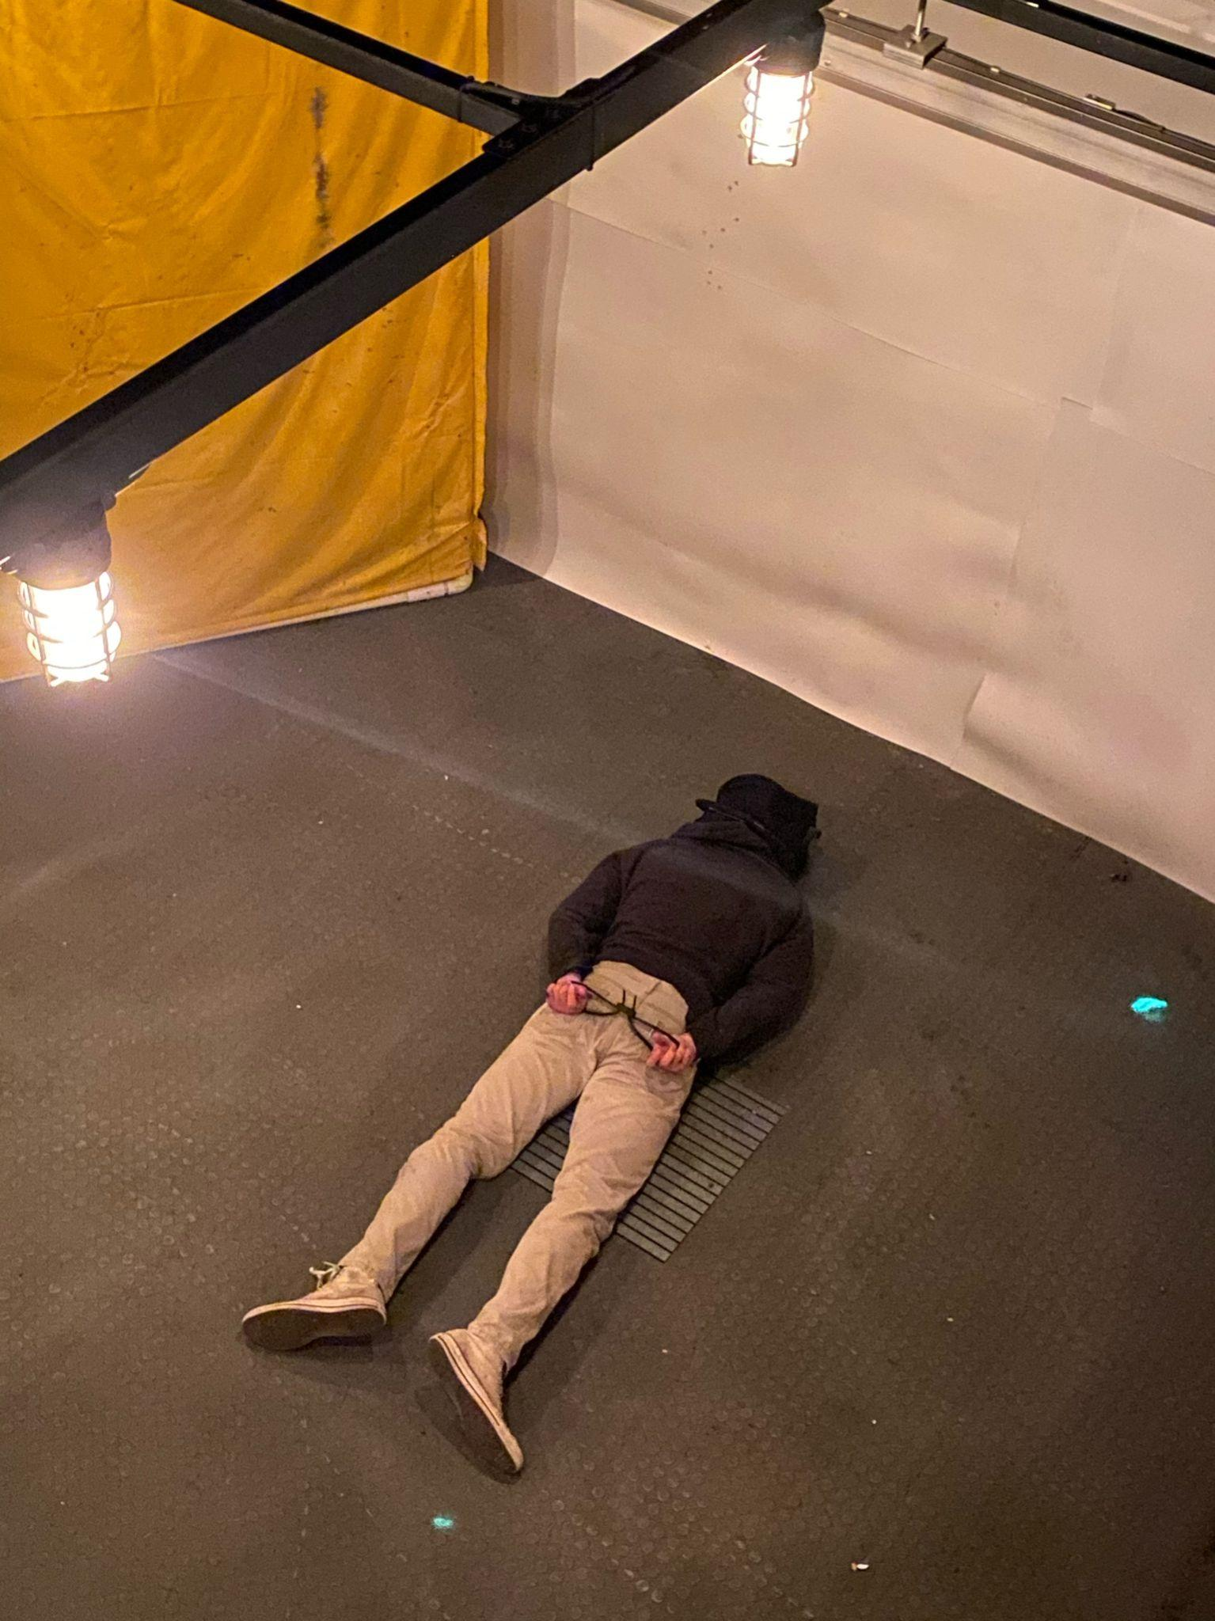
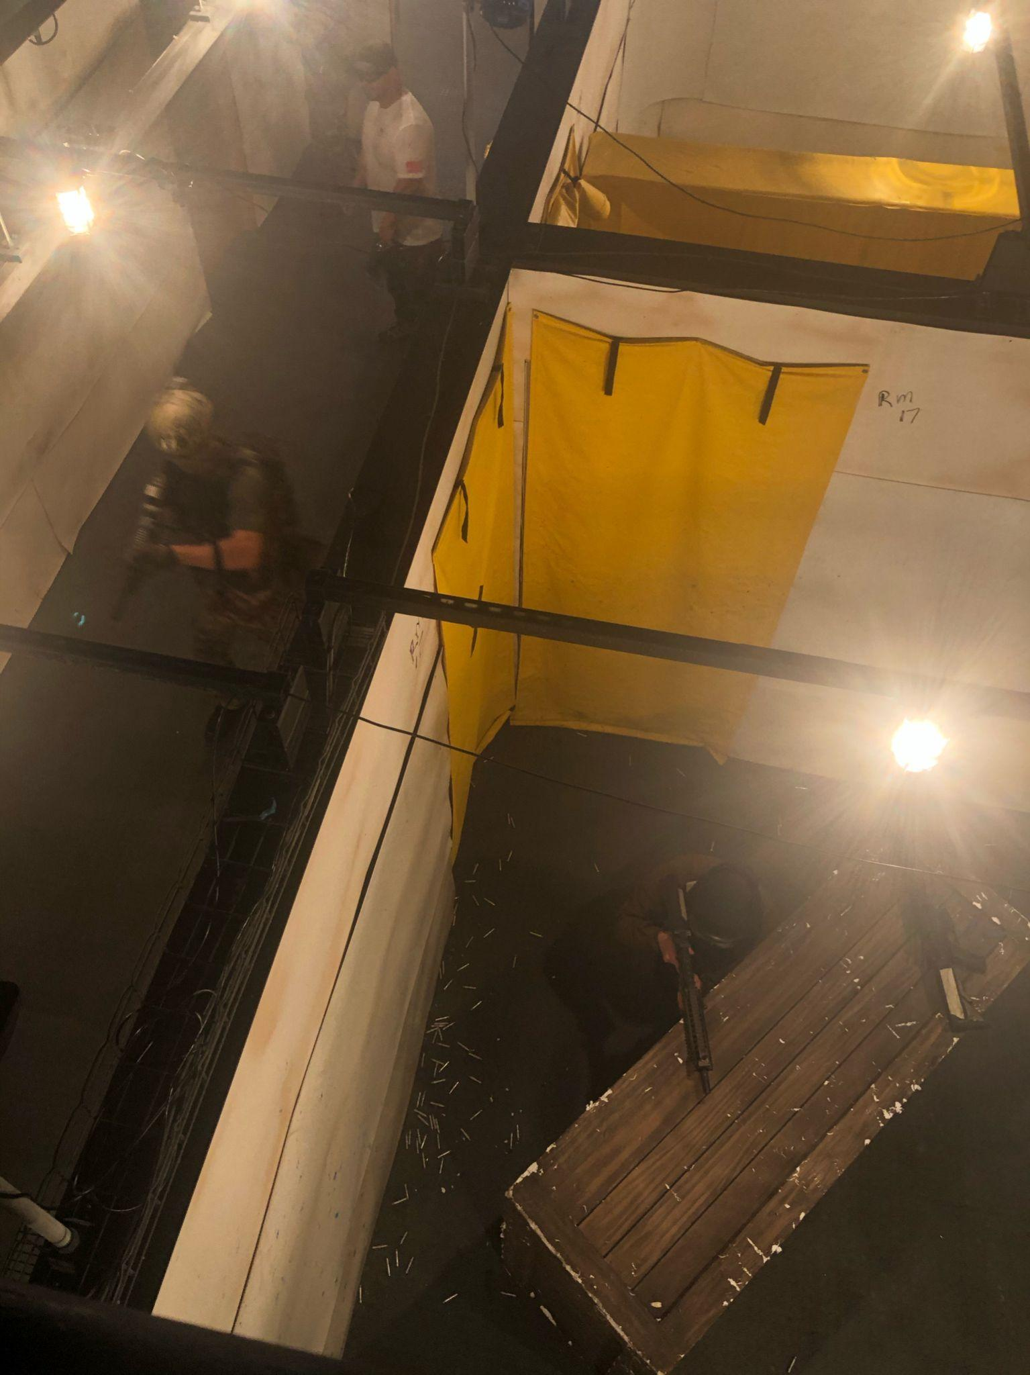
UNCLASSIFIED//FOUO
NSW PTE BLOCK 3
Observing platoons from Team 8 conduct live fire building clearing and CQC techniques at Ft. Story.
Finishing the USNA “down man” Endurance course. Three sand-babies and a stretcher was split between 2 groups of 5.
Shooting and instruction at an indoor range with LT Kuenzle at JEB Little Creek.
Role Playing in support of Team 8 CQC ULT. This included acting as unarmed unknowns and hostile targets armed with UTM training rounds. Role Playing and observation at TRADET was the largest aspect of this training.
UNCLASSIFIED//FOUO

Slide 7
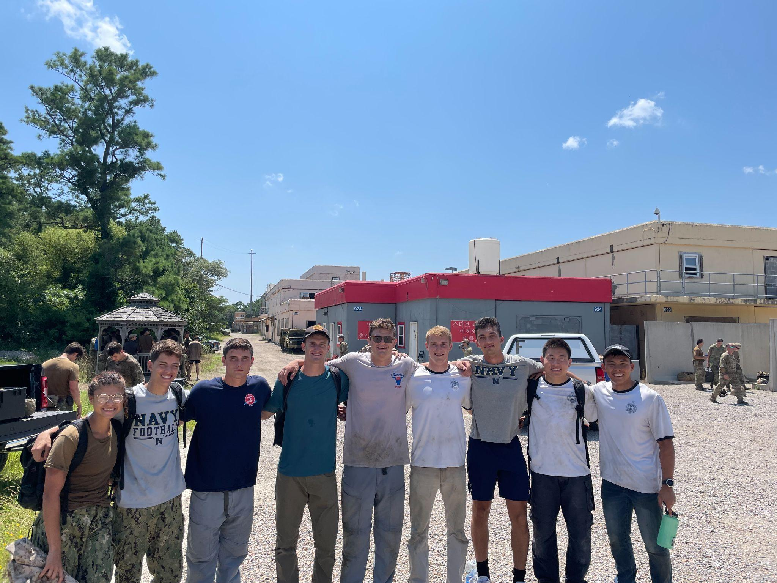
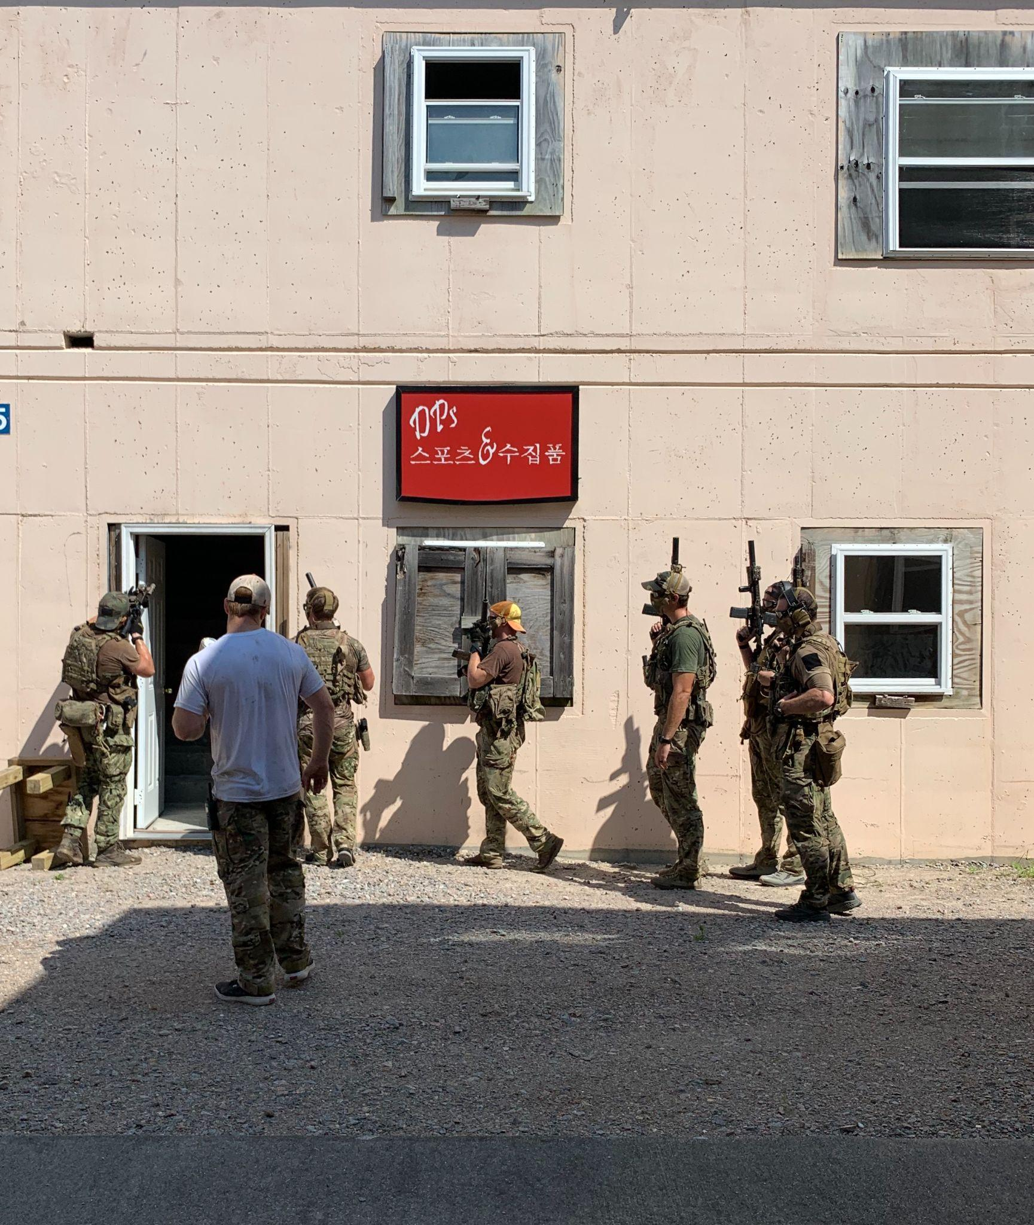
UNCLASSIFIED//FOUO
NSW PTE BLOCK 3
PTE OIC Comments: This training exceeded every participants expectations with the volume of NSW exposure and knowledge gained. The experiences shown were invaluable by providing insight to NSW operations, mentorship opportunities and teamwork skills. We hope to take these experiences forward with us in hopes of broadening the Brigade’s exposure to this community.
The final day of role playing at Fort Story. The week of CQC training for team 8 culminated with exercises being conducted within the houses of an artificial town.
UNCLASSIFIED//FOUO

Slide 8
NSW 2/C PTE
Purpose - to expose rising 2/C to Naval Special Warfare, allowing them to be better-informed candidates and understand NSW’s role in the DOD.
This does not replace or simulate SOAS or the 2/C SEAL Screener and is not intended to be an evaluation.
A valuable firsthand experience beyond the limited exposure to NSW on the yard.

Slide 9
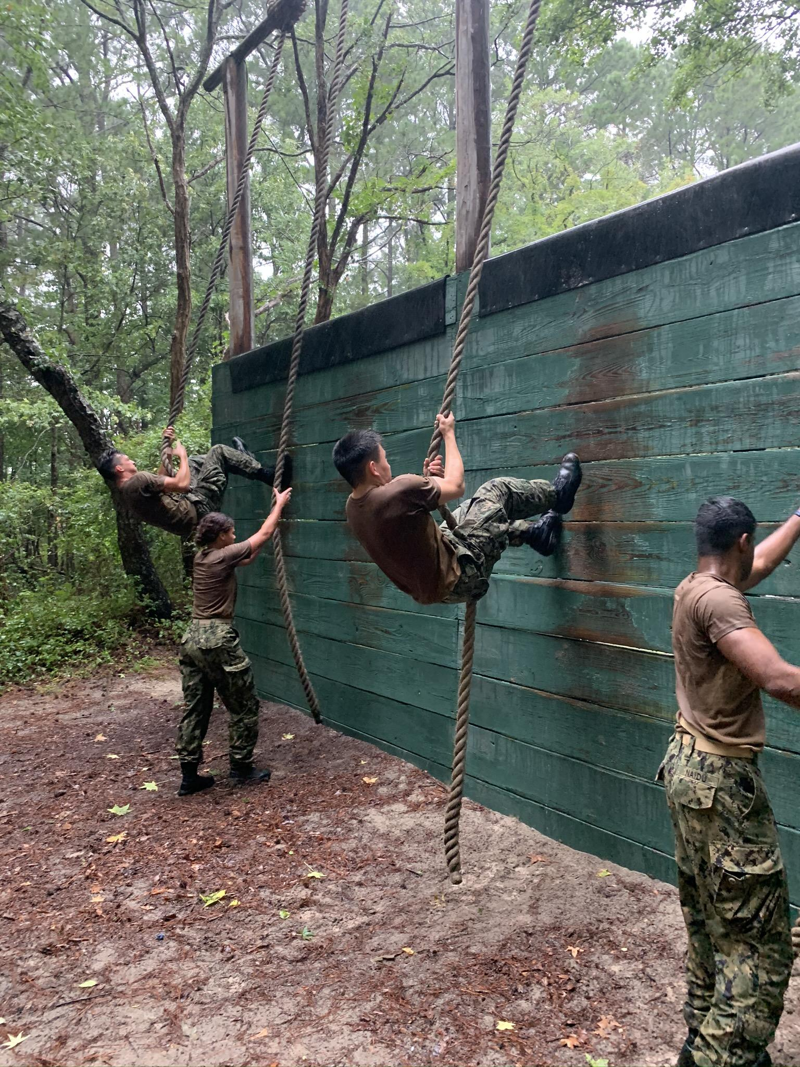
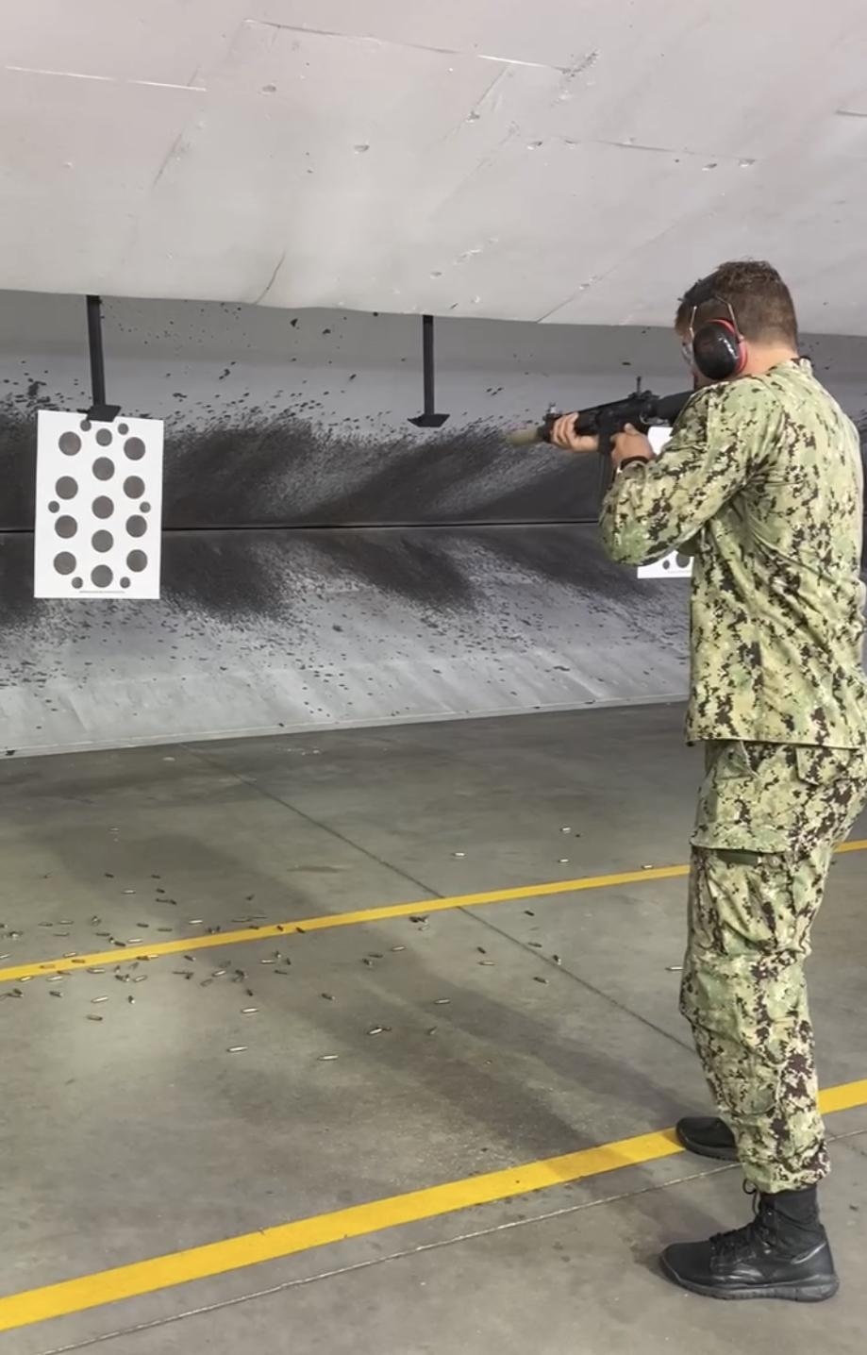


NSW PTE Week 2 (JEB Little Creek)
NSW O-Course familiarization
Shooting instruction at NSW Center East indoor range
Multi-Purpose Canine Demonstration
Acting as OPFOR in support of CQC training

Slide 10
NSW PTE Lessons Learned
NSW’s Unique Value Proposition - conduct clandestine, special operations missions in various domains to include land and cyberspace, but primarily undersea, surface and over-the-beach capabilities (in support or independent of land/cyberspace operations).
NSW shifting focuses to maintain its competitive edge
Countering Violent Extremist Organizations to Great-Power Competition
Land Warfare/Close Quarters Combat to Maritime Operations
Pipeline and responsibilities of NSW Officers
NSW Community Culture and Family
New “Whole Person” view of officer candidate selection

